Slide 1
Application of high-throughput molecular biology technologies to biological processes for biodegradation & bioenergy production from wastewater
Christopher M. Sales
Drexel University
March 12, 2013

Slide 2
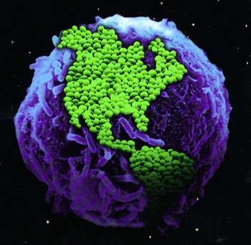
The Amazing Microbial World
“The role of the infinitely small in nature is infinitely large.” – Louis Pasteur

Slide 3
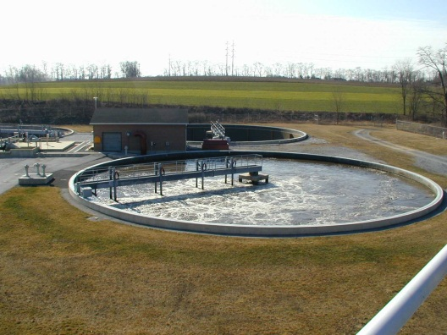
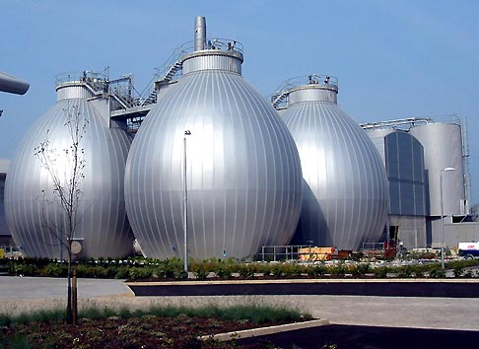
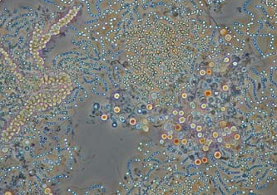
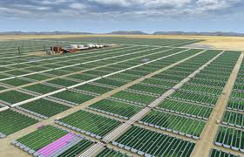
Microbes, Humans, and the Environment
Since the late 1800s, environmental engineers have been harnessing the catalytic potential of microbes to protect the health of humans and the environment.
High BOD
Activated Sludge Process
Low BOD
Organic Waste
Anaerobic Digesters
CH₄
Hazardous Contaminant
In situ soil bioremediation
Benign Product
CO₂
Algae Photobioreactors
Lipid-rich Algae

Slide 4
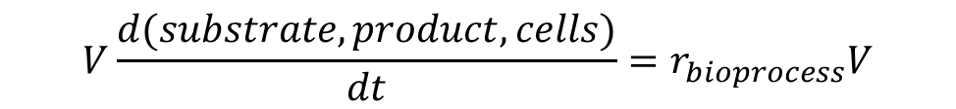
“Black Box” Approach to Biological Processes
Application of reactor theory and chemical kinetics are powerful tools for engineering biological processes…
High BOD
Activated Sludge Process
Low BOD
Reactants
(substrates)
Organic Waste
Anaerobic Digesters
CH₄
Products
Hazardous Contaminant
In situ soil bioremediation
Benign Product
CO₂
Algae Photobioreactors
Lipid-rich Algae
$$V\frac{d(substrate, product, cells)}{dt}=r_{bioprocess}V$$

Slide 5
“Black Box” Approach to Biological Processes
…however, the “black box” approach limits our understanding of the underlying microbial systems, and thus our ability to engineer them…
Reactants
(substrates)
Products

Slide 6
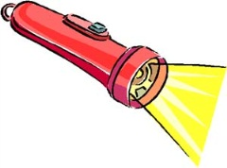
Peeling back the “Black Box’’
Advances in high-throughput molecular and analytical techniques provide tools to shed light on complex microbial systems
Reactants
(substrates)
Products

Slide 7
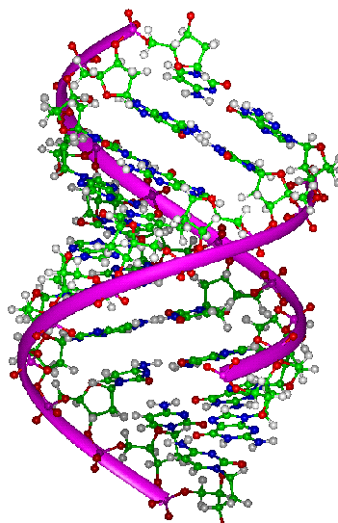
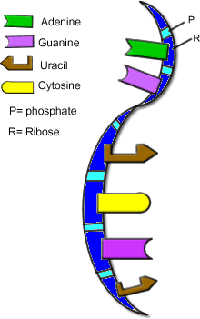
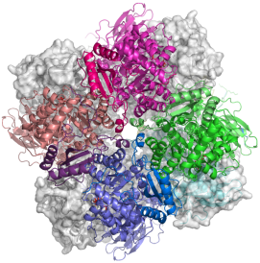
Central Dogma of Molecular Biology
Biodegradation and biosynthesis processes are catalyzed by enzymes!
Replication
Transcription
Translation
DNA
(genes)
RNA
(transcripts)
Proteins
(enzymes)
Notes:
Protein Image: http://xray.bmc.uu.se/~michiel/research.php

Slide 8
Era of “omes” and “omics”
Advances in high throughput techniques, such as next generation sequencing technologies, enable the study of “everything” in microbiology.
DNA
(genes)
single genes
genomes
all genes of an organism
METAGENOMES
all genes of a microbial community
Notes:
Protein Image: http://xray.bmc.uu.se/~michiel/research.php

Slide 9
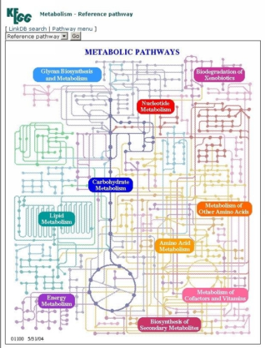
Era of “omes” and “omics”
DNA
(genes)
RNA
(transcripts)
Proteins
(enzymes)
Metabolites
genomes
transcriptomes
proteomes
metabolome
METAGENOMES
METATRANSCRIPTOMES
METAPROTEOMES
METAMETABOLOME
Notes:
Protein Image: http://xray.bmc.uu.se/~michiel/research.php

Slide 10
Application of “omics” to Environmental Engineering
“Omics” technologies provide tools for a systems biology approach to study the complex interactions that are central to the physiology and function of environmental biological processes
Reactants
(substrates)
Products

Slide 11
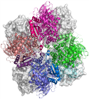
Application of “omics” to Environmental Engineering
“Omics” technologies provide tools for a systems biology approach to study the complex interactions that are central to the physiology and function of environmental biological processes
Reactants
(substrates)
Products

Slide 12
APPLICATION OF “OMICS”
TO
1,4-DIOXANE BIODEGRADATION

Slide 13











Acknowledgements
UC Berkeley
Lisa Alvarez-Cohen
Ariel Grostern (Post-doc)
Weiqin Zhuang (Post-doc)
UCLA
Shaily Mahendra
UC Davis
Becky Parales
Juan Parales
UW-Madison
Jonathan Klassen (Post-doc)
Washington University in St. Louis
Yinjie Tang

Slide 14
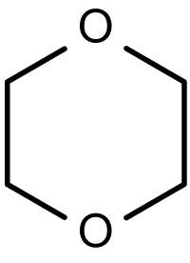
Emerging contaminant: 1,4-dioxane
Health Concerns
Confirmed animal carcinogen
Probable human carcinogen (Class B2)
Toxicities to kidney, liver, lungs, nasal cavity, and gall bladder
Cases of fatal occupational exposure (inhalation)

Slide 15
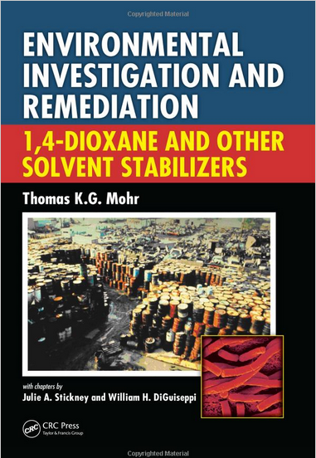
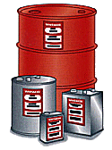


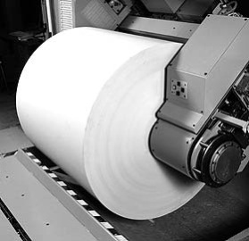
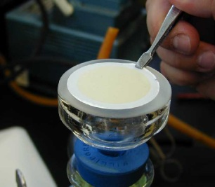
Emerging contaminant: 1,4-dioxane
Sources
Stabilizer in 1,1,1-trichloroethane (1,1,1-TCA), a.k.a. methyl chloroform
Primary Care Products (shampoos and cosmetics), as a byproduct of ethoxylation reaction
Solvent in paper and textile processes, such as dialysis filters

Slide 16
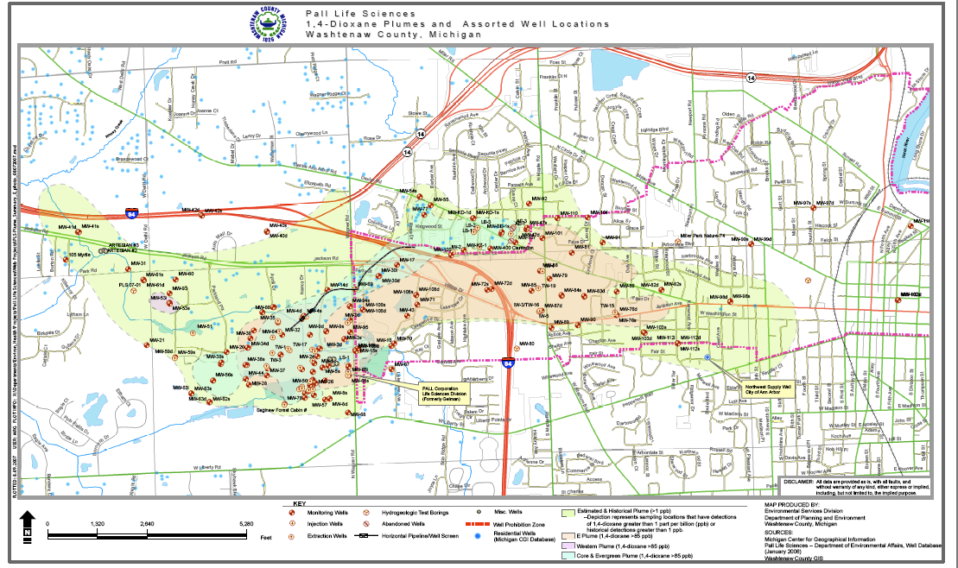

Emerging contaminant: 1,4-dioxane
Environmental concerns
High Solubility → Large Plumes
No Federal MCL
On the USEPA 3rd Contaminant Candidate List (CCL)
Demonstration of degradation by advanced oxidation processes and … Fungi and Bacteria!
3 ug/L
Notification Level
1,4-dioxane contamination
in groundwater
up to 212,000 ug/L
(Fotouhi et al., 2006)
From Environmental Sciences Division, Washenaw County, MI

Slide 17

Biodegradation of 1,4-dioxane
Background
Pure and mixed cultures of fungi and bacteria primarily degrade 1,4-dioxane aerobically
Mainly co-metabolic degradation (i.e., need an inducing substrate for growth and to promote degradation)
To date, can be metabolized as carbon and energy source by only 9 isolates
Biochemical evidence for the involvement of monooxygenase (MO) enzymes in aerobic biodegradation of 1,4-dioxane [i.e., methane MO, propane MO, toluene MO, tetrahydrofuran (THF) MO]
$$RH+O_{2}+2e^{−}+H^{+}\overset{→}{monooxygenase}ROH+H_{2}O$$

Slide 18
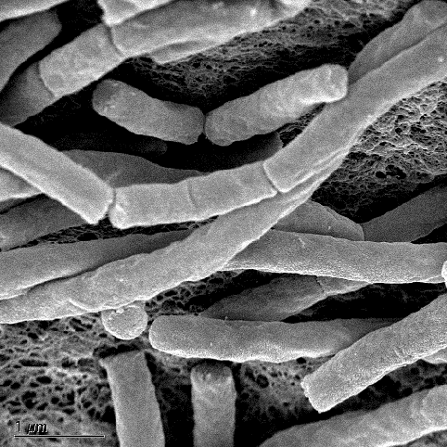
Pseudonocardia dioxanivorans CB1190
(a.k.a, strain CB1190)
Isolated from 1,4-dioxane contaminated sludge (South Carolina)
Gram-positive actinomycete
Grows on 1,4-dioxane and other ethers, including another cyclic ether tetrahydrofuran (THF)
Ability to fix CO₂
Ability to fix N₂
References: Parales et al., (1994) AEM; Mahendra & Alvarez-Cohen (2005) IJSEM

Slide 19
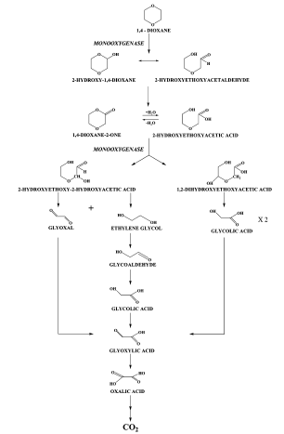
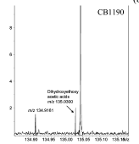
Proposed metabolic pathway
1,4-dioxane degradation pathway
(Mahendra et al., 2007, ES&T)
Strain CB1190
Based on detected in-vivo intermediates using ESI-MS and FTICR-MS
Mineralization and incorporation into biomass confirmed by ¹⁴C-tracer study
However, enzymes are unknown!

Slide 20
Functional genomics approach
Use genome of strain CB1190 to identify the enzymes involved in 1,4-dioxane metabolism.
Replication
Transcription
Translation
DNA
(genes)
RNA
(transcripts)
Proteins
(enzymes)
genomes
Notes:
Protein Image: http://xray.bmc.uu.se/~michiel/research.php

Slide 21
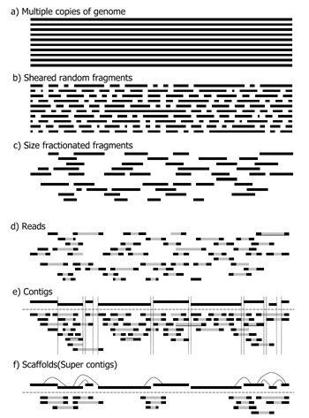

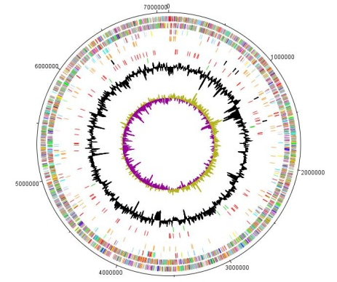
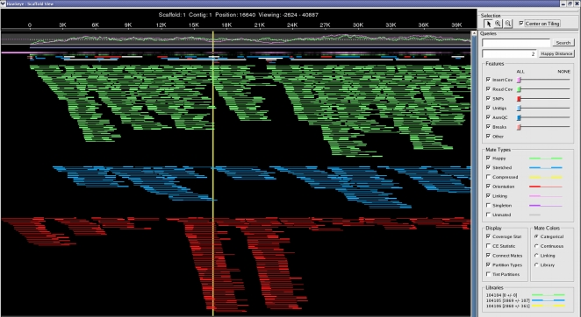
Genomic Sequencing at JGI
Isolation of
genomic DNA
Whole-genome shotgun sequencing
P. dioxanivorans CB1190
Alignment, assembly and annotation
Genome Map

Slide 22

Pseudonocardia dioxanivorans CB1190 Genome
Genome consists of four genetic elements:
chromosome
3 plasmids
Feature | Genome | Chromosome | Plasmid pPSED01 | Plasmid pPSED02 | Plasmid pPSED03
Topology |  | Circular | Circular | Circular | Linear
Length | 7,440,794 bp | 7,096,571 bp | 192,355 bp | 136,805 bp | 15,603 bp
G+C Content | 73.12% | 73.41% | 71.15% | 68.38% | 61.83%
Coding Density | 87.2% | 88.5% | 76.1% | 80.0% | 69.2%
Coding Sequences | 6,797 | 6,495 | 172 | 116 | 14
Pseudo genes | 226 | 194 | 20 | 11 | 0
Average CDS length | 963 bp | 967 bp | 946 bp | 851 bp | 744 bp
rRNAs | 3 | 3
tRNAs | 47 | 47
Hypothetical proteins | 1,842 | 1,692 | 88 | 51 | 11
From Sales et al. (2012). J. Bacteiol. and Sales et al. (2013) submitted

Slide 23

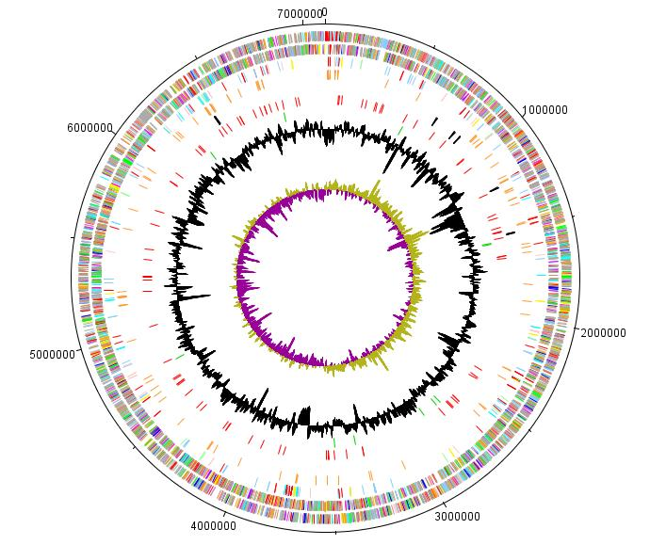
Pseudonocardia dioxanivorans CB1190 genome
Search for monooxygenases
Strategy 1:
Keyword search for “monooxygenases”
Result → 84 genes annotated as MOs!
Strategy 2:
Sequence similarity search to subunits of multi-component monooxygenases
Propane MO (prmABCD)
Phenol MO (dmnLMNOP)
Toluene MO (tmoABCDE)
Result → 8 multicomponent MOs
CB1190 Chromosome
Sequence
Structure
Function

Slide 24
CB1190 Monooxygenases
Eight multicomponent MOs
All located on chromosome, except THF MO (plasmid pSED02)
From Sales et al. (2012). J. Bacteiol. and Sales et al. (2013) submitted

Slide 25
Application of Transcriptomics
Problem: Which monooxygenase is involved in the hydroxylation of 1,4-dioxane?
Solution: Use transcriptomics!
Transcription
Translation
1,4-dioxane degradation activity
DNA
(genes)
RNA
(transcripts)
Proteins
(enzymes)
genomes
transcriptomes
Notes:
Protein Image: http://xray.bmc.uu.se/~michiel/research.php

Slide 26
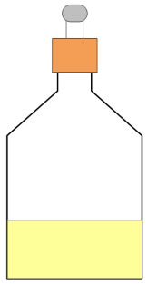
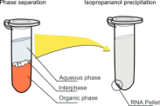
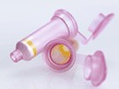
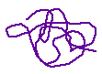


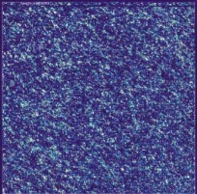
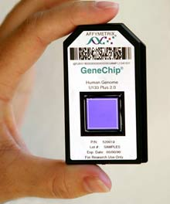
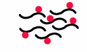
Transcriptomics of 1,4-dioxane biodegradation
Whole genome expression analysis of CB1190 grown on 1,4-dioxane and glycolate (intermediate) using microarrays
Extract nucleic acids
Isolate and purify total RNA
Synthesize cDNA
Quantify in qPCR
Label cDNA
Signal reading
Hybridize to microarray

Slide 27
Transcriptomics of 1,4-dioxane biodegradation
Example of Transcriptomics Microarray Data Analysis
From microarray study of propane-enhanced bacterial degradation of the water contaminant N-nitrosodimethylamine (NDMA)
Microarray study described in Sharp, Sales et al. (2007). AEM.

Slide 28
Transcriptomics of 1,4-dioxane biodegradation
Comparison of CB1190 grown on 1,4-dioxane vs. glycolate
Results:
383 genes were differentially expressed
  97 genes up-regulated on 1,4-dioxane
  286 genes down-regulated on 1,4-dioxane
The only MO up-regulated was the THF MO gene cluster (thmADBC) located on plasmid pPSED02
From Sales et al, (2013) submitted

Slide 29
Revision of upper-portion of 1,4-dioxane pathway
Strain CB1190 genome was used to identify protein-encoding genes involved in upper pathway
Up-regulation of genes verified by transcriptomics further supported their involvement
From Grostern, Sales et al. (2012) AEM; Sales et al, (2013) submitted

Slide 30
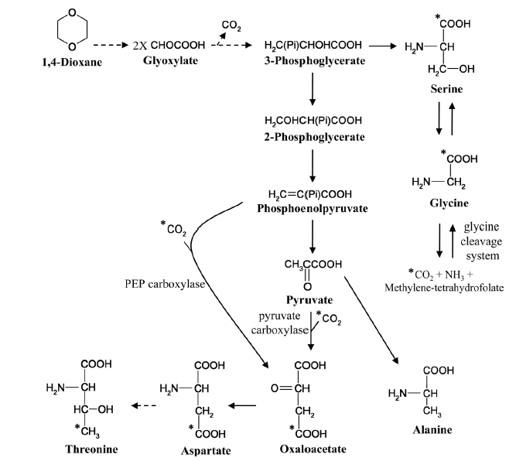
Metabolomics of 1,4-dioxane biodegradation
Uniformly ¹³C-labeled 1,4-dioxane tracer study
Unlabeled carbon indicated with an asterisk (*)
From Grostern, Sales et al. (2012). AEM.

Slide 31
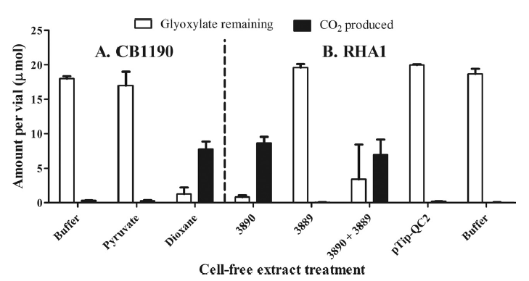
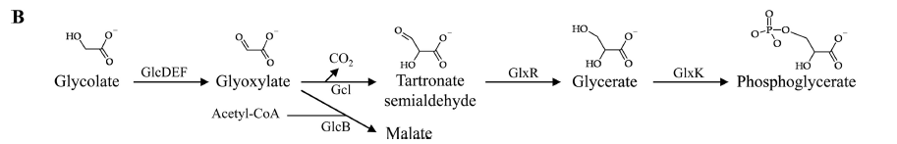
Revision of lower portion of 1,4-dioxane pathway
Heterologous expression of putative glyoxylate degradation genes in Rhodococcus jostii RHA1
Tartronate semialdehyde reductase, GlxR (3389)
Glyoxylate carboligase, Gcl (Psed_3890)
From Grostern, Sales et al. (2012). AEM.

Slide 32
Revised pathway
Revised 1,4-dioxane biodegradation pathway annotated with enzymes, using genomics, transcriptomics, and metabolomics.
From Grostern, Sales et al. (2012). AEM.

Slide 33

Closer look at upper pathway
Hydroxylation of 1,4-dioxane and HEAA
Is it the same or different MO?
  Genomics and transcriptomics studies not sufficient to verify involvement in both 1,4-dioxane and HEAA degradation
  Activity of THF MO on hydroxylation of 1,4-dioxane or 1,4-dioxane can only be confirmed by heterologous expression in another host of thm gene cluster or genetic deletion (knockout) from strain CB1190
1,4-dioxane
?
HEAA
2-hydroxyethoxyacetic acid

Slide 34
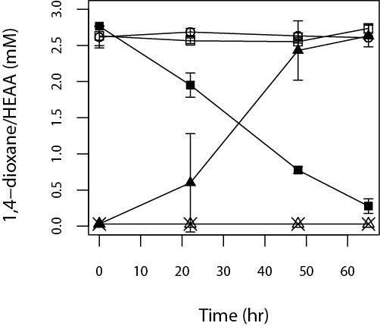
Confirmation THF MO Functional Activity
Heterologous expression of thm genes
THF MO (thmADBC) was successfully expressed on a vector in the host Rhodoccocus jostii RHA1
Results indicate THF MO can hydroxylate 1,4-dioxane, but not HEAA
YES!
thmADBC
1,4-dioxane
NO!
HEAA
thmADBC
From Sales et al. (2013). In prep.

Slide 35
Application of “Omics” to 1,4-dioxane biodegradation
Summary
Combination of approaches led to the identification of the genetic basis of 1,4-dioxane metabolism
  Microbiology, molecular biology, and biochemical methods
  High-throughput techniques (genomics, transcriptomics, metabolomics),
Determined and verified the involvement of THF MO in the hydroxylation of 1,4-dioxane
  Genetic biomarkers can now be designed to
    Identify the potential for 1,4-dioxane biodegradation at a contaminated site
    Monitor the gene expression of 1,4-dioxane-degrading enzymes during bioremediation efforts

Slide 36


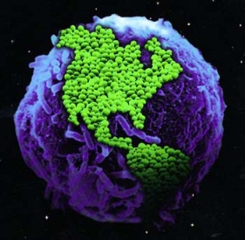
Water and Energy Nexus
Water
Energy
Biological Systems

Slide 37
OPPORTUNITIES FOR USE OF
HIGH-THROUGHPUT TECHNIQUES IN
ENGINEERING
WASTE-TO-ENERGY BIOTECHNOLOGIES

Slide 38
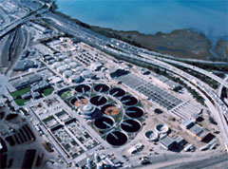
Wastewater Treatment Plants (WWTPs)
Main goal is to protect natural water bodies by removal of
  oxygen-demanding substances in wastewater
  nitrogen and phosphorous compounds in wastewater
WWTPs…successful in removal, but in general, are wasteful…
Image: EBMUD
CO₂
N₂
Raw
Wastewater
(High Organics;
High NH₃;
High P)
Treated
wastewater
(Low Organics;
Low NH₃;
Low P)
Primary
Treatment
Secondary
Treatment
Tertiary
Treatment
O₂
Waste Sludge
(primary solids)
Waste Sludge
(Biomass)
P-rich Sludge
(Biomass)

Slide 39

Rethinking Wastewater Treatment
WWTPs as Sustainable Resource Recovery Plants
Recovery of water resource
Recovery of nutrients (e.g., N and P)
Recovery of biosolids for agricultural use
Recovery of energy from sludge or wastewater
Energy
Source
Protein
Source
CO₂
N₂
Raw
Wastewater
(High Organics;
High NH₃;
High P)
Treated
wastewater
(Low Organics;
Low NH₃;
Low P)
Primary
Treatment
Secondary
Treatment
Tertiary
Treatment
O₂
Energy
Source
Waste Sludge
(Biomass)
P-rich Sludge
(Biomass)

Slide 40
Waste-to-Energy Biotechnologies
Biological processes
Biogas production (anaerobic digesters)
Bioelectricity production (microbial fuel cells)
Biohydrogen production
Biofuel production (algal photobioreactors, fermenters)
Wastes
Energy

Slide 41
Waste-to-Energy Biotechnologies
Application of high-throughput techniques (omics)
Metagenomics
  Discover novel organisms, enzymes, pathways
  Study the evolution (natural or adaptive) of microbial community structure and key functional genes
Metatranscriptomics
  Understand molecular and biochemical interactions regulating enzyme production (activity)
Meta-metabolomics
  Characterize key metabolic pathways
  Identification of rate-limiting biochemical reactions
  Examine exchange of nutrients and metabolites between organisms

Slide 42
Final Remarks
“Omics” can be applied in combination with other methods to study environmental biological processes
“Omics” can provide insight into the microbial and molecular systems that control the function of environmental biological processes
“Omics” has the potential to revolutionize our approach to studying and engineering biological processes for environmental sustainability

Slide 43
Questions?

Slide 44
Additional Slides

Slide 45
Shale Gas and Microorganisms
Potential areas of research related to environmental impacts of hydraulic fracturing and biological systems
Development of microbial source tracking methods for monitoring releases caused by hydraulic fracturing activity
Investigate the effects of high TDS, metals, and biocides in flow-back and processed waters from hydraulic fracturing on biological processes for wastewater treatment (i.e., activated sludge)
Study changes in microbial activity important to biogeochemical cycles (particularly carbon) in soils and sediments near shale oil and gas extraction sites

Slide 46
Central Dogma of Molecular Biology
Replication
Transcription
Translation
DNA
(genes)
RNA
(transcripts)
Proteins
(enzymes)
Notes:
Protein Image: http://xray.bmc.uu.se/~michiel/research.php

Slide 47
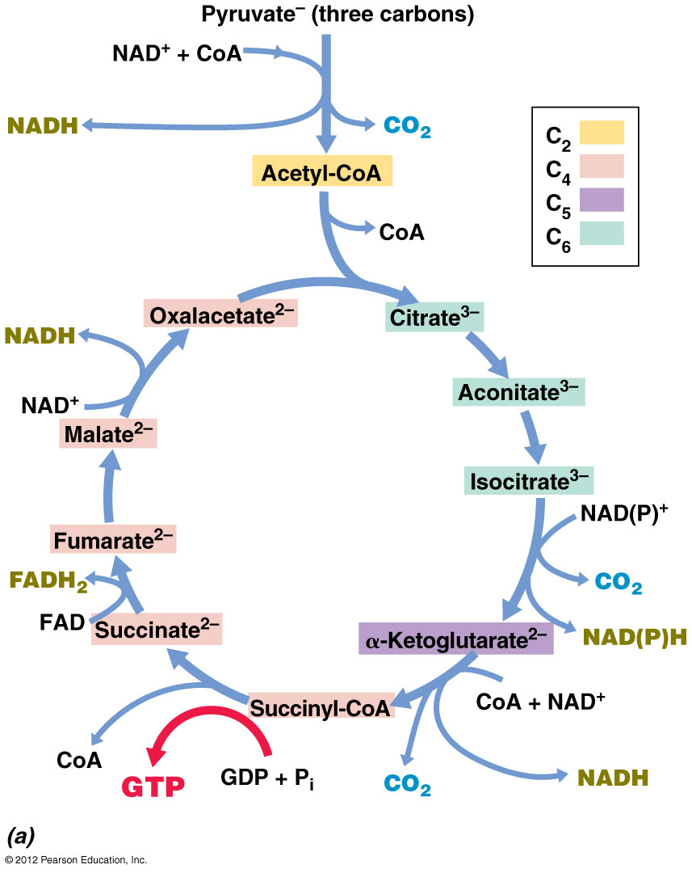
Metabolic Pathways
Multiple enzyme reactions are required in metabolic pathways.
(e.g., citric acid cycle for metabolizing pyruvate into CO₂)

Slide 48
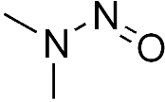
Chemical Properties
Property | 1,4-dioxane | NDMA
Molecular weight | 88.11 | 74.08
Density | 1.028 g/cm³ | 1.0059 g/cm³
Water solubility | Miscible | Miscible
Boiling point | 101.2⁰C | 154⁰C
Vapor pressure | 5.08 kPa at 25⁰C | 0.36 kPa at 25⁰C
Octanol-water partition coefficient (log K_{ow}) | -0.27 | -0.57
Organic carbon partition coefficient (log K_{oc}) | 1.23 | 1.079
Henry’s law constant (H_{c}) | 4.80 x 10⁻⁶ atm-m³/mol | 2.63 x 10⁻⁷ atm-m³/mol
Henry’s law constant (dimensionless, H_{c*}) | 1.96 x 10⁻⁴ | 1.1x10⁻⁵
ª Sources: USEPA, 2010; Mohr et al., 2010 and references therein
^{b} Sources: ATSDR, 1989; USEPA, 2008

Slide 49
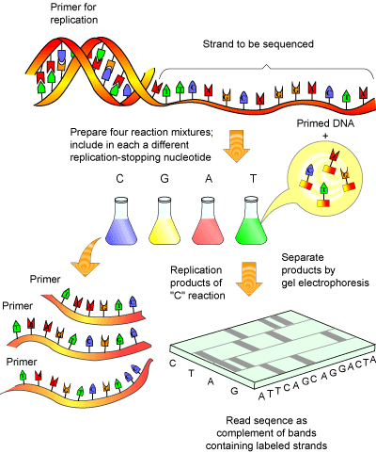
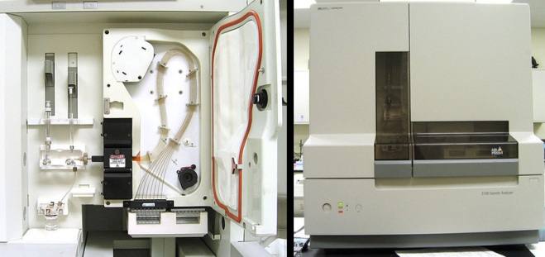
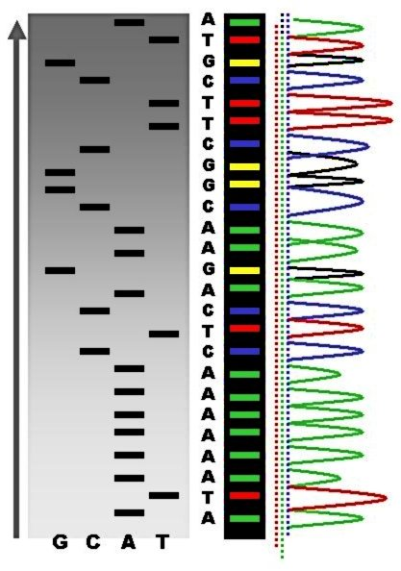
Genome Sequencing
Sanger Sequencing (1975)
Dye-based
Average sequence length: 800 bp
Method for producing draft of human genome (2001)
Human Genome: 3.4 Gb (billion bp)
Bacterial Genomes: ~ 1-10 Mb (million bp)
Applied Biosystems Inc.,
Capillary Electrophoresis
Sequencer
http://www.scq.ubc.ca/genome-projects-uncovering-the-blueprints-of-biology/

Slide 50
Producing the Genome
Circular Genome Map

Slide 51
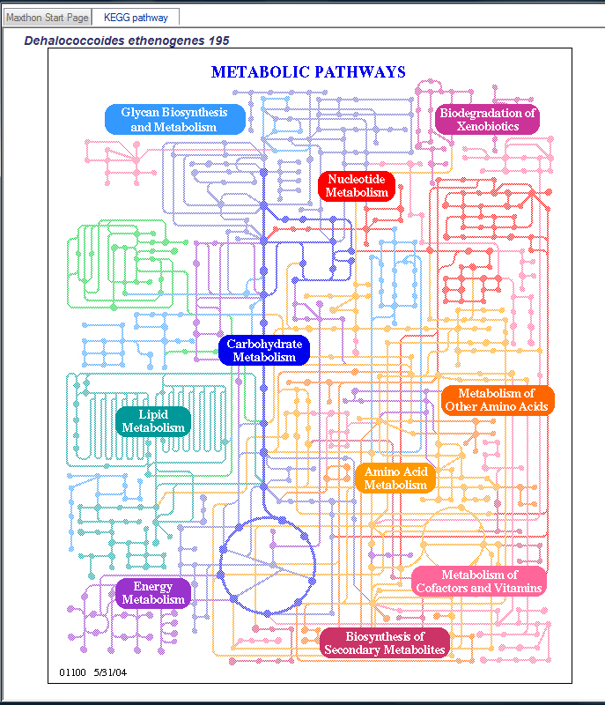
Genomics
Circular Genome Map
Predict Function & Physiology

Slide 52
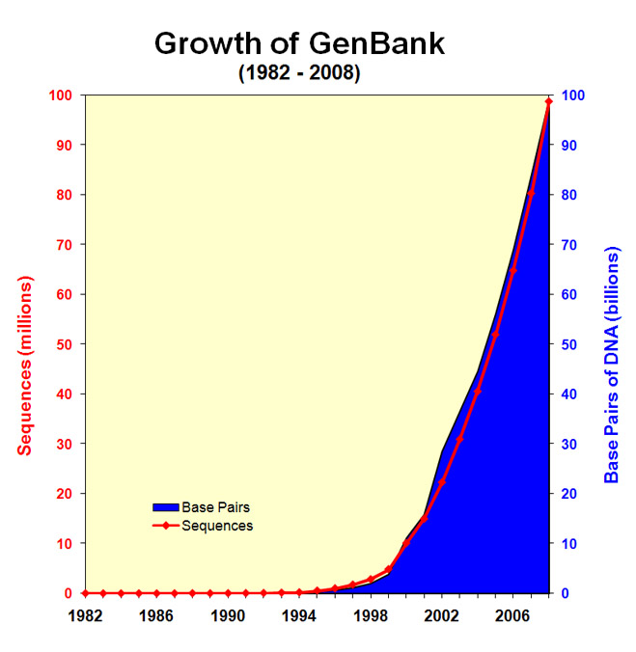
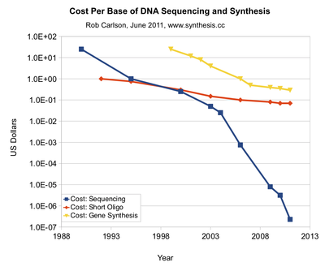
Next Generation Sequencing (NGS)
http://www.ncbi.nlm.nih.gov/genbank/genbankstats-2008/
Human Genome (3.4 Gbp):
2000 - $15.3 billion (4.5x Coverage)
2012 - $3,400 (1000x Coverage)

Slide 53
Next Generation Sequencing (NGS)
454 Pyrosequencing
200-400bp
0.1-1 GB/run
Illumina HiSeq
100-200bp
100 GB/run
Pacific Biosciences
10,000 bp?
?GB/run
2000
2005
2010
2013
Sanger
800 bp
0.01 GB/run
Illumina/Solexa
GAI/GAII
25-50 bp
1-10 GB/run
Ion Torrent
Nanopore
200 bp
0.8GB/run
Increasing speeds, Decreasing Costs
Variability in Errors/Accuracy

Slide 54
CB1190 Genome Sequencing Statistics
Date Released | Technology | Library Type | Average Read Length (bp) | Number of Reads
June 2009 | 454 | Single reads | 250 | 472 000
June 2009 | 454 | Single reads | 380 | 702 000
June 2009 | 454 | 20 Kb mate-pair | 380 | 2 400
Oct. 2009 | 454 | 10 Kb mate-pair | 380 | 143 000
Oct. 2009 | Illumina | Single reads | 36 | 33 000 000
Feb. 2010 | 454 | 3 Kb mate-pair | 380 | 65 000

Slide 55

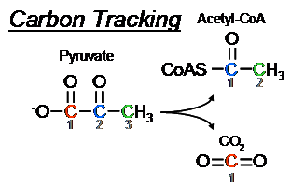
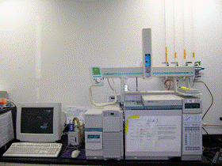
Metabolomics
¹³C-Tracer Analysis
Labeled carbon substrate
¹³C1-C2-C3-C4-C5-C6
Intracellular fluxes
Glycolysis
PP Pathway
bio-products + biomass
TCA Cycle
Metabolites
Isotopomers
Agilent 5973
Adapted from Tang, 2007
m_{o}
m₁
m₂
m₃

Slide 56
Cornerstone of bioinformatics
Exploit relationships among
Particularly, interested in how,
  Sequence similarity relates to homology
  Homology relates to the structure, function, and evolution of a protein
Sequence
Structure
Function
  Definition: Homology is the relationship of two sequences or structures that have descended from a common ancestor.

Slide 57
Environmental Engineers & Bioinformatics
Environmental engineers can utilize bioinformatics tools
    to sort
    to manage
    to analyze
copious amounts of information that characterize complex
biological systems (e.g., wastewater treatment plants, wetlands, contaminated soils)…
…in order to monitor (or manipulate) the numbers and types of enzymes (or organisms) that influence the forms and rates of bioremediation.

Slide 58
Up-regulation of Propane MO
From Sharp, Sales et al. (2007). AEM.
Expression levels. White (□), RT-qPCR and gray (■) spotted microarray. No prmB probes on microarray.

Slide 59
Genetic Knockouts of MOs
From Sharp, Sales et al. (2007). AEM.
Where □ = wild-type RHA1; ▲ = knockout mutant RHA1ΔalkB; ◊ = knockout mutant RHA1ΔprmA; and ● = no cell control. Cells were grown in LB medium and harvested in the late exponential phase of growth. 200 mg NDMA⁻¹ was added to each sample and NDMA monitored over time. Error bars portray the mean deviation of biological replicates.

Slide 60
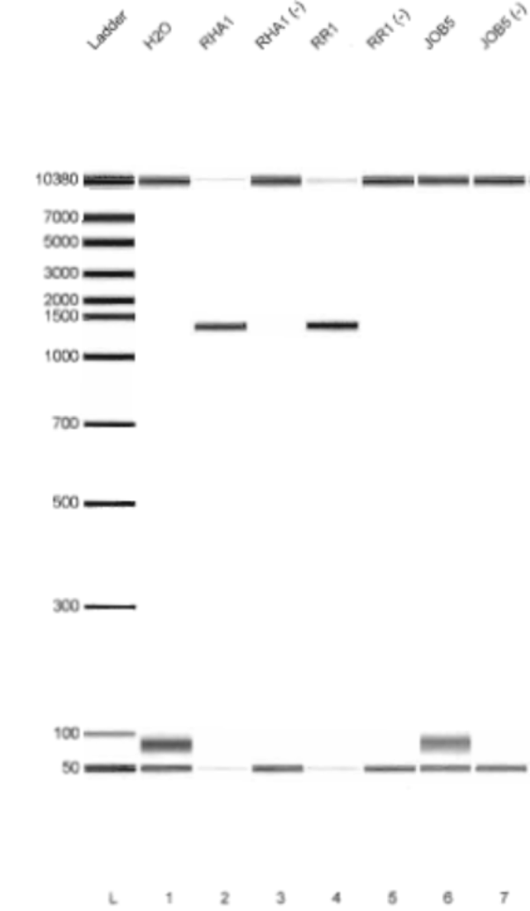
Biomarkers for Propane MOs
Made oligonucleotide primers for PCR (PrMO Biomarker)
Based on multiple sequence alignment of known propane MO sequences
Expect PCR amplicon of 1400 bp
Primer only positive for Rhodococcus jostii RHA1 and Rhodococcus RR1 (not Mycobacterium vaccae JOB5)
Can be used to make predictions for in vivo bioremediation
From Sales et al. (2010). AEM.

Slide 61
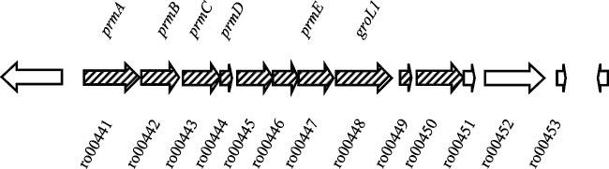
Omics guided NDMA degradation research
Summary:
Propane-enhanced, co-metabolic NDMA biodegradation is observed in RHA1 (like RR1)
Propane MO operon (prm) is up-regulated during growth on propane in RHA1 and RR1, but not JOB5
RHA1 prm genetic mutant unable to degrade NDMA

