Slide 1
Fume Hood – Proper Handling of Chemicals / Proper Functioning
Simge Uzun
June 5th, 2018

Slide 2
Fume Hood Safety
Properly functioning fume hood prevents us from:
Harmful fumes/vapors
Inhaling chemicals
Potential fire or explosions from chemicals
When should we use a fume hood?
When handling toxic, volatile, bad odor, and respirable chemicals.
Performing exothermic synthesis when vapors can cause fire.
Handling chemicals with higher vapor pressure.

Slide 3
Working Principle
Fresh air is drawn into the fume hood and contaminated air is expelled outside the building.
Vertical Sash
Horizontal Sash

Slide 4
Fume hood vs. Biosafety Cabinet
Fume hood
Biosafety Cabinet
Designed to provide both a clean work environment and protection for work with biological hazards.
Designed to remove fumes/vapors away from the work area.

Slide 5
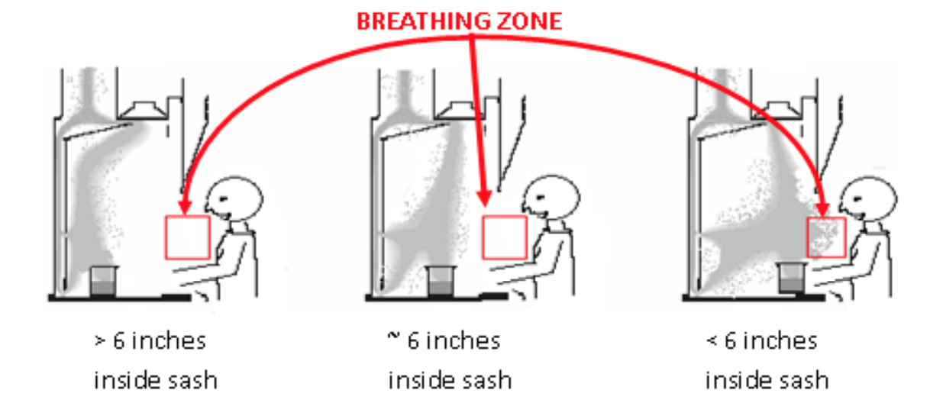
Best Practices to Use Fume Hood
Work at least 6 inches inside the hood to keep vapors from exiting. All equipment should be at least 9-12 inches away from the hood face.
Minimize storage inside the hood. Keep at least 50% of the work area clear, if possible.
Open and close sash slowly, and avoid swift arm and body movement near and inside the hood. Movement increases turbulence and reduces containment effectiveness.

Slide 6
Best Practices to Use Fume Hood
Properly store your chemicals. Never store chemicals for long periods.
Exhaust slots at the back of the hood always need to be clear.
Remove spark sources or electrical units from the hood while working with flammable liquids or gases.
Always clean your waste from hood. Make sure your experiment is not a source of contamination for others experiments.

Slide 7
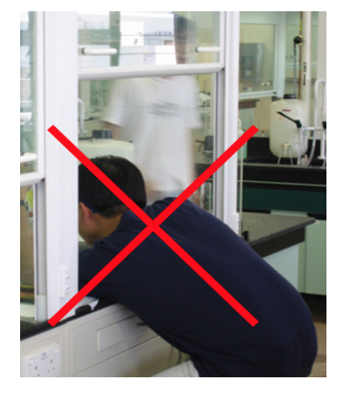
Best Practices to Use Fume Hood
Never lean your head inside the fume when experiment is going on.
Keep sash at 18 inches or less while working in the hood to protect from chemical splashes/fire/explosion.

Slide 8
Best Practices to Use Fume Hood
Close sash completely when a “no hands” portion of an experiment is in progress.
Close sash when finished work or when leaving experiments or chemicals unattended.
Do not remove sash or leave it completely open. The only time the sash should be fully open is during experiment set up.

Slide 9
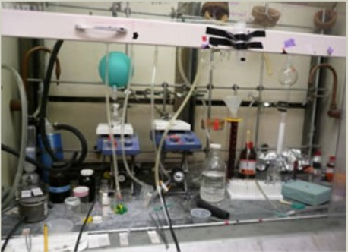
Best Practices to Use Fume Hood
All electronics should be connected outside of the fume hood.
Electrical cords should not prevent the closing of the sash.
Only use a hood for the function it was constructed for. Some materials require specific fume hoods.

Slide 10
Best Practices to Use Fume Hood
Close the sash immediately after you finish your experiment. It will save energy and increase safety.
Make sure fume hood is drawing air properly. This can be ensured from the digital meter besides the fume hood.
Properly label your samples. This is extremely important for all of us!

Slide 11
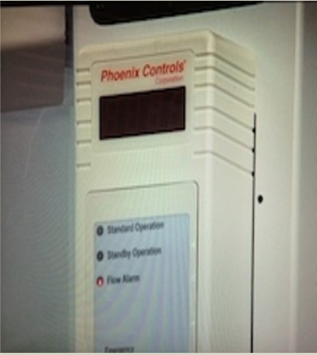
Fume Hood Malfunction Detection
Airflow monitors indicate state of fume hood.
Green light means exhaust is working.
Red light means exhaust is not working.
A face velocity value greater than 80 means exhaust is working.
An audible alarm means the exhaust is not working.
If fume hood is not functioning properly, cease all hazardous work and notify your supervisor.

Slide 12
Resources
https://drexel.bioraft.com/rafttraining/course/142
http://nano.materials.drexel.edu/wp-content/group-info/resources/Fume_hood_safety.pdf

