Slide 1
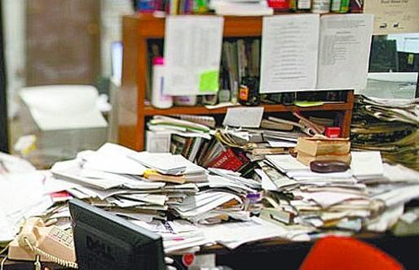
Lab Organization
Contact Xu Xiao
Updated, June 2018

Slide 2
Why is organization so important?
Keeps non-compatible chemicals from being stored with each other
Helps us find chemicals/supplies
Keeps us efficient
Keeps us safe

Slide 3
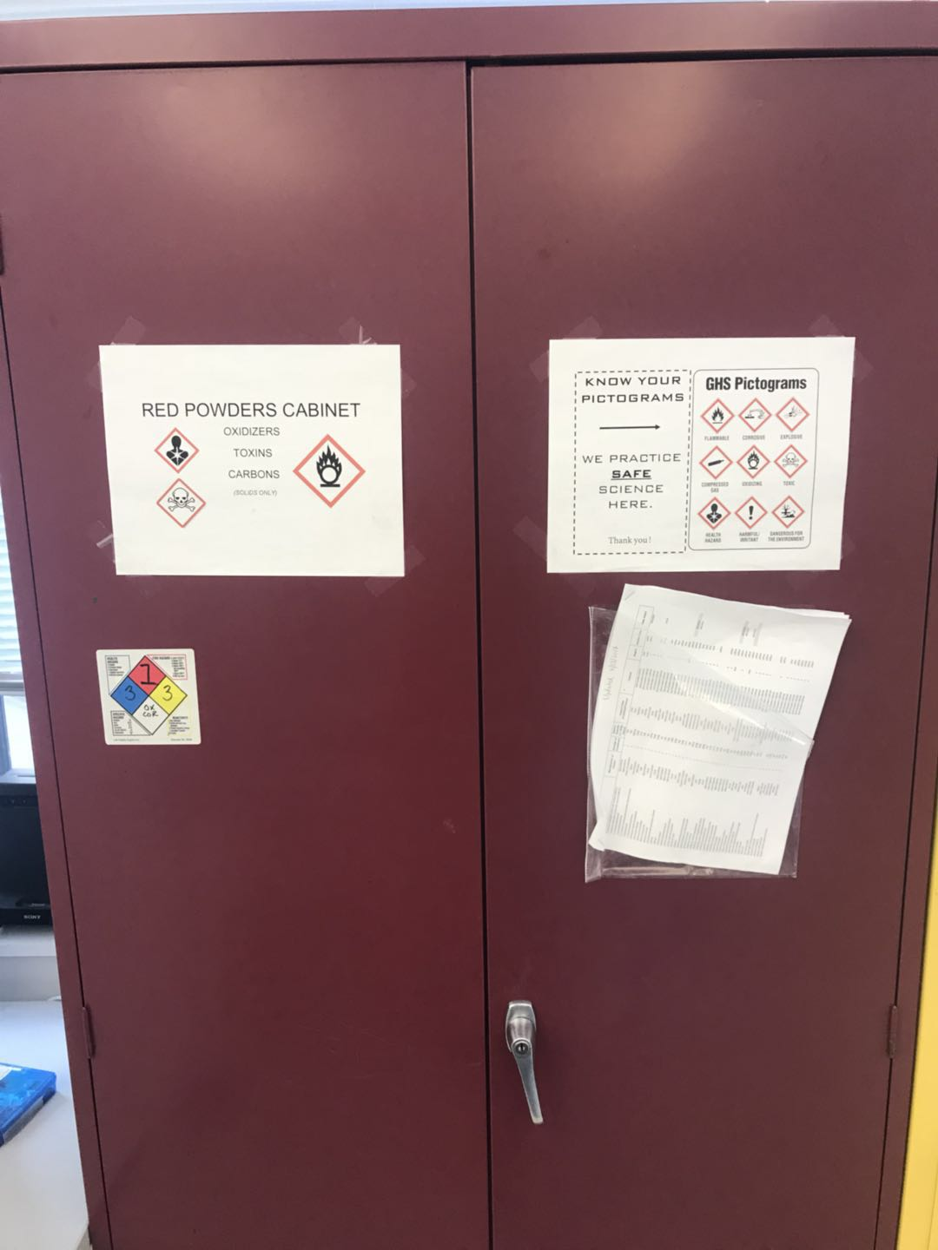
How are chemicals stored?
By CLASS:
Flammables
Acids
Inorganic
Organic
Bases
Oxidizers
Reactives
Poisons (toxins)
Non-hazardous/irritant
It is also listed in the black inventory binder located under the gloves in Bossone 525

Slide 4
Solids vs Liquids?
Solids and liquids should never be stored beside each other on the same shelf (unless you have a secondary container)
Liquids should never be stored above eye level
Do not store liquids in upper cabinets
Liquids should never be stored ABOVE solids
Examples: in the caustic/base cabinet, the top shelf is dedicated to solids

Slide 5
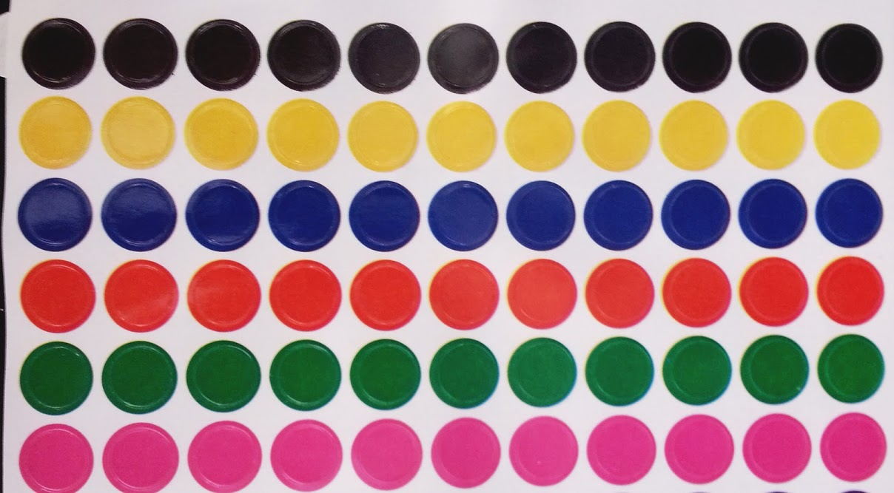
Bossone 525 Sticker System
Each chemical is labeled with a colored sticker and so are the shelves
Green stickered items should be placed on green stickered shelves
If you are color blind, please let us know.
Any confusion, always ask someone for help!
Disclaimer: The stickers are not intended to be representative of a chemical class, or replace hazard labels on chemicals. They refer to location only.
DO NOT STORE REAGENT CHEMICALS IN YOUR PERSONAL DRAWERS.
CARBON
POISON
OXIDIZER
CORROSIVE
IRRITANT/NON-HAZARDOUS
POLYMER

Slide 6
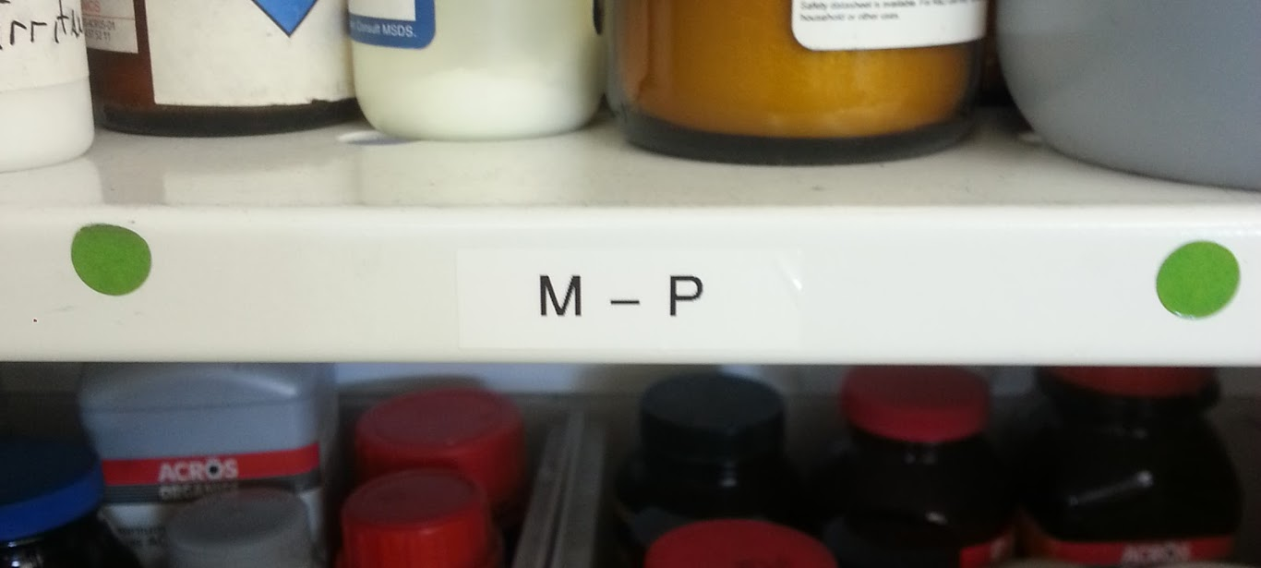
White Cabinet (Powders ONLY)
Carbon
Things that safety does not want to see stored together
FLAM/OX
CORR/OX
This cabinet is organized alphabetically by sticker color. The shelves are labeled with appropriate locations.
Return everything where you got it from and if you think something is placed in the wrong spot, ask!
Oxidizers
Irritant/
non-hazardous
Poison/Toxic
Corrosive
Polymer
Carbon

Slide 7
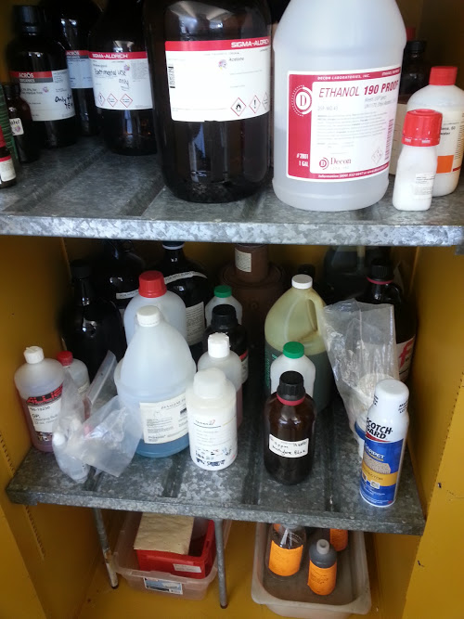
Flammables (Yellow Cabinet)
This is where we find ethanol/acetone and other frequently used solvents (NO SOLIDS)
Bottom shelf is WASTE ONLY (contact Mykola for info on waste/waste removal)

Slide 8
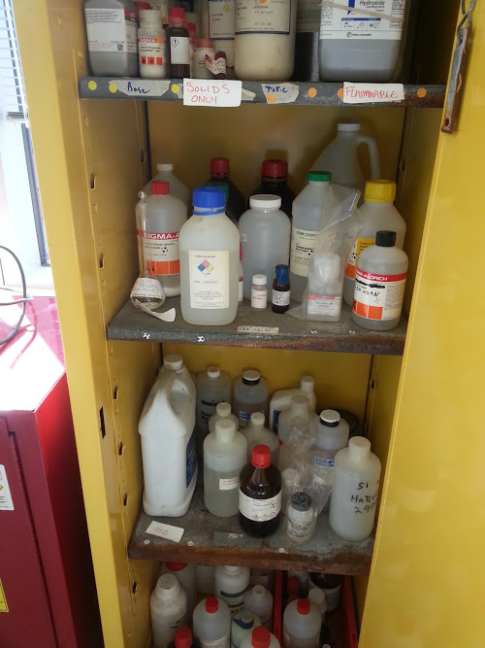
BASES/CAUSTIC
Yellow cabinet
Top shelf: solids only
2nd shelf: liquid bases
3rd shelf: oils

Slide 9
ACIDS
organics acids and inorganic acids are separated by left and right hoods (check inventory for location)
Solids are in their own secondary containers (top shelf only)
You’ll notice, some acids are stored in their own secondary container and are labeled accordingly.

Slide 10
Flammables (Hood)
Top: small liquid bottles/solids in secondary container
Bottom: larger flammable liquids
The flammables are separated under the left and right hoods (check inventory for location of chemicals)

Slide 11
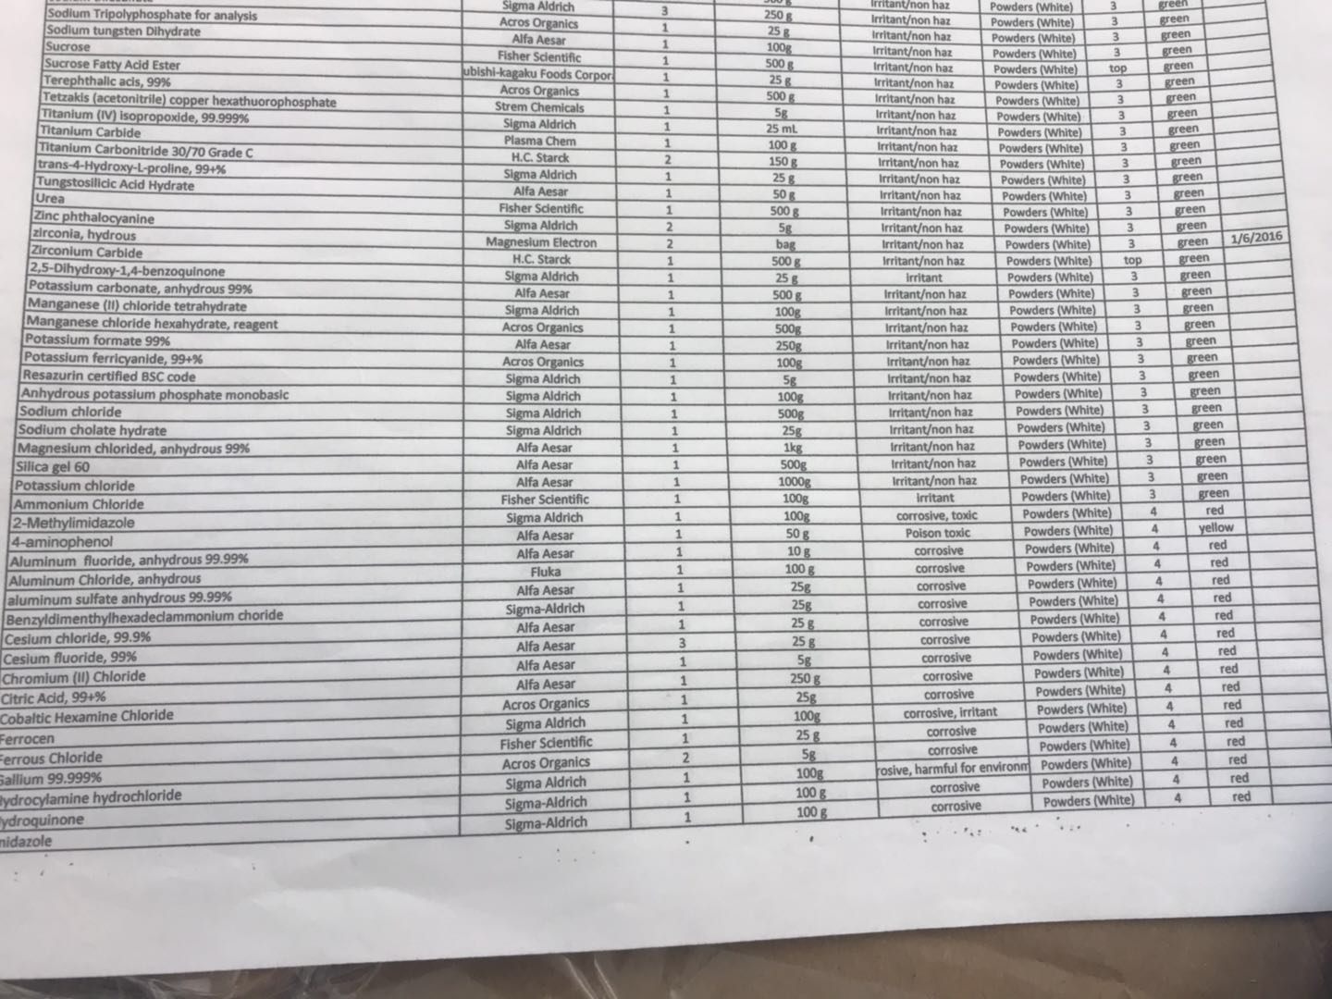
Chemical Inventory
Each cabinet has an inventory attached to the outside
A full list can be found in the chemical inventory binder
Any new/replacing chemicals must be added/removed to the list
Any questions can be directed to Christine cbh52@drexel.edu and chemical ordering can be directed to Mykola ms4427@drexel.edu

Slide 12
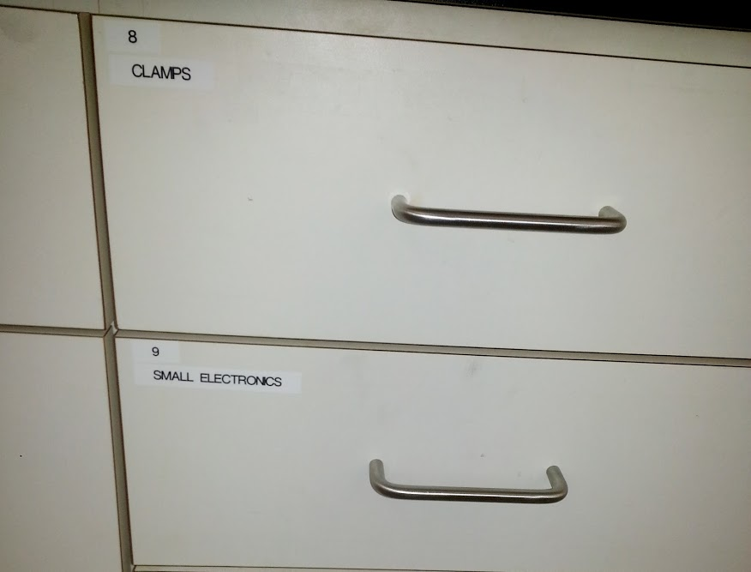
Drawer/Supplies Organization
Each of the lab drawers are numbered. This number corresponds to a list which displays the location of everything in our lab.
Use this list to find what you need and please return everything to the correct location

Slide 13
Last Words
Keep our lab clean and organized!

