Slide 1
Glove Box
Safety presentation for DNI

Slide 2
What is inside the glove box
A glove box is a sealed container that is designed to allow one to manipulate objects where a separate atmosphere is desired.
Two types of gloveboxes exist:
1. allows a person to work with hazardous substances
2 allows manipulation of substances that must be contained within a very high purity inert atmosphere (our lab now)
Materials in the glovebox:
Air-sensitive
Water-sensitive
Toxic
Biohazard
Radioactive

Slide 3
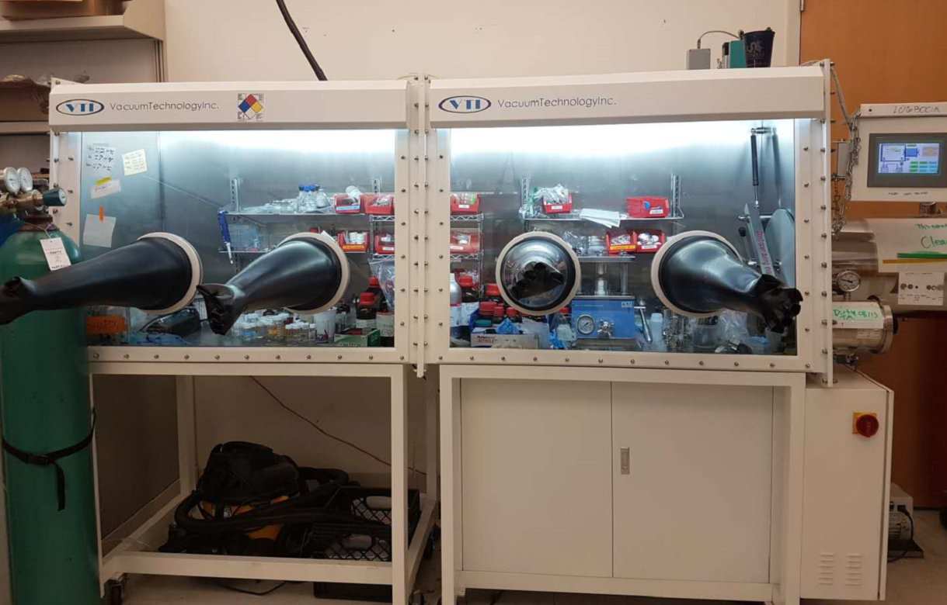
General introduction of glove box in our lab
Metal
Ar cylinder
Organic solvents
And users’ boxes

Slide 4
Safety Features of a Glove Box
Positive pressure to the atmosphere
- if there is leakage in the glovebox, it will be in the lab!
Glove boxes will automatically close their valves when there isn’t a proper pressure of compressed gas
If the glove box cannot be refilled with inert gas, the glove box can remain for a few hours to a few days
Moisture and Oxygen sensors

Slide 5
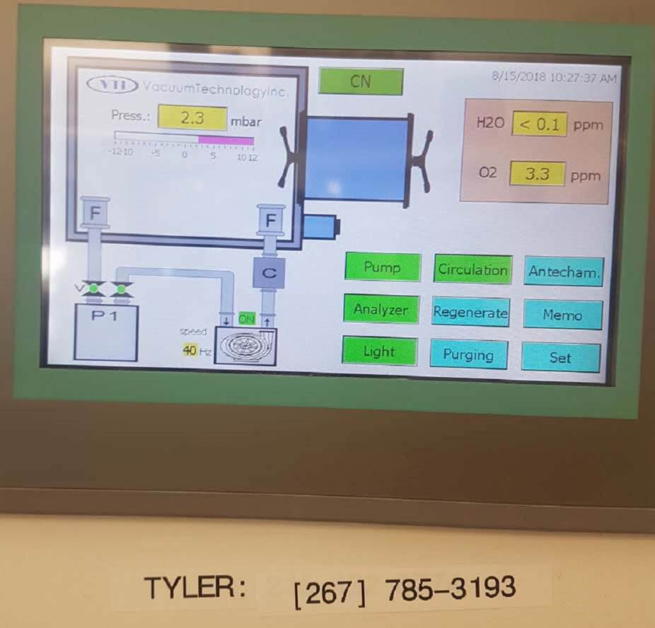
General introduction of glove box in our lab
Control
panel
Supercapacitor part
Battery part

Slide 6
Transfer sample into glovebox
Chambers: change the air environment into inert atmosphere by vacuuming the chamber and refilling the chamber with gas in the glove box
Large chamber:
There is limited space in the glove box, so large equipment should be kept to a minimum. Check the possibility with super users first.
Small chamber:
Ensure equipment can withstand vacuum conditions
Glassware - Glassware should be dried in an oven for at least a few hours before bringing it into the box. If you cannot do this, you can remove much water from the glass by doing a rinse with EtOH or MeOH then hexanes. Flame drying is also an option.
Chemicals – non-volatile solids should be opened and covered with a Kim wipe/rubber band unless packaged under inert atmosphere. Volatile material: next page

Slide 7
How to put sample into glove box
Ar cylinder
Large chamber
Small chamber

Slide 8
Transfer sample into glovebox
Chambers: change the air environment into inert atmosphere by vacuuming the chamber and refilling the chamber with gas in the glove box for 3 times
Large chamber:
There is limited space in the glove box, so large equipment should be kept to a minimum. Check the possibility with super users first.
Small chamber:
Ensure small equipment can withstand vacuum conditions
Glassware - Glassware should be dried in an oven for at least a few hours before bringing it into the box. If you cannot do this, you can remove much water from the glass by doing a rinse with EtOH or MeOH then hexanes. Flame drying is also an option.
Chemicals – non-volatile materials should be opened and covered with a Kim wipe/rubber band unless packaged under inert atmosphere. Volatile material: next page

Slide 9
Transfer hazardous chemicals into glovebox
Solvents:
Consider the solvents that are being used in the glove box and are being brought into the glove box
What are their boiling points? Are they halogenated? Could they contain water?
General rules:
Whenever shipping any chemical into the glove box, it is important to look at the characteristics of the chemical: Will it react with the chemical inside the glovebox? do risk assessment.
Depending on the boiling point of the chemical, it could evaporate due to the dip in pressure
Refer to the MSDS for moisture level
Check the label to see it’s purity; the impurities may be trapped water or solvent
(easier rule: chemicals that have never opened in the air is preferred)

Slide 10
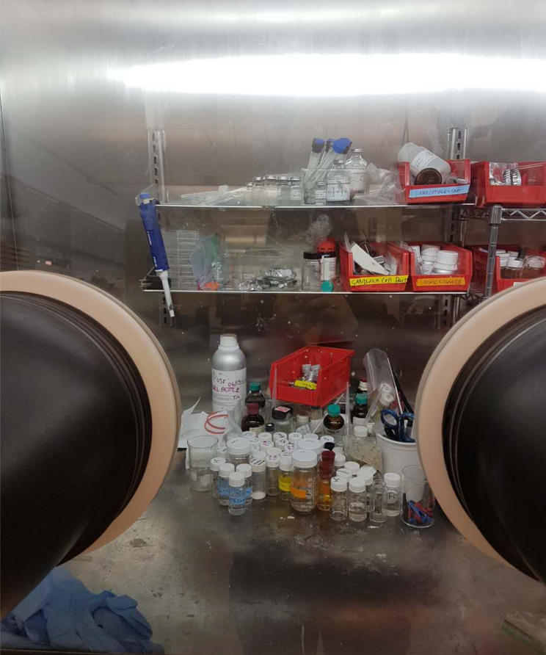
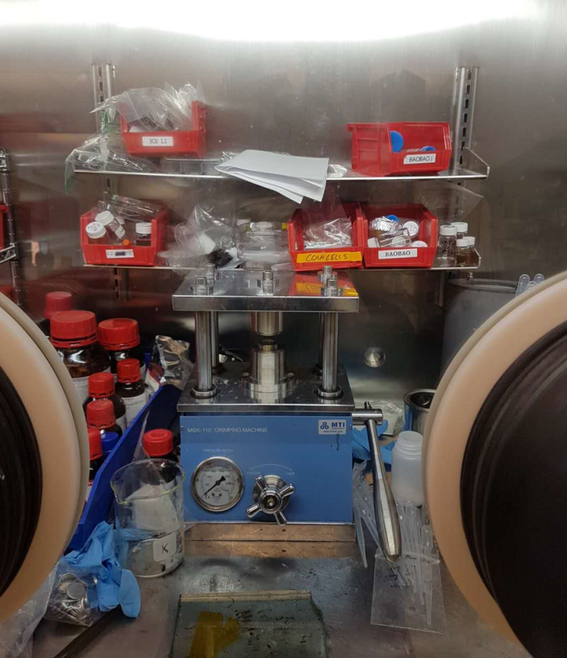
View of glove box
Left
Right

Slide 11
Glove box practices: check list before start
Before using the glovebox:
Inspect the condition of the glove box Gloves: Are there tears? Are they firm?
Compressed Gas: Are there any leaks? When was the regulator/fitting last checked? Are there gas in the bottle? (Ar bottle!!!)
Ante-chamber: Are there any products/equipment?
Vacuum Pump: How is the pump oil level? Does it sound like it’s working properly? Are there any leaks?
Before putting your hand in the glove box, put on a pair of glove (finger can be sharp to the glove box) and ensure hands are dry
Enter the glove box slowly; if you enter to suddenly, you may rip off the gloves
Before the operation in the glove box, put on another disposable gloves to ensure the cleanness of the black glove.

Slide 12
Rules when using the glove box
Maintenance, diligence and proper inspection when working in a glove box will prevent many incidents
Be careful when using sharp things inside glove box
Be mindful of the side-products; if the reaction generates a harmful gas, maybe it isn’t the right reaction to be done in the glove box
If O2 and H2O level is increasing fast
Or beyond 50 ppm
Contact super user immediately

Slide 13
Emergency Situations
At any time, users should be prepared for the following emergencies to occur
Power failure
Loss of gas pressure
Glove tear/repair
In all instances, the user’s safety is most important
If there is a loss of power to the panel, there is NO safe way to introduce inert gas into the glove box.
Depending on the state of the glove box and their regular maintenance, glove boxes can last anywhere for 12-48 hours without a refill of gas
In cases of pressure loss, stop using. The glove box seal itself until the pressure is sufficient to continue regular operation
Please keep the glove box tidy and clean!!
-Separate trash and sharp
-Clean after use
-Use a log book

Slide 14
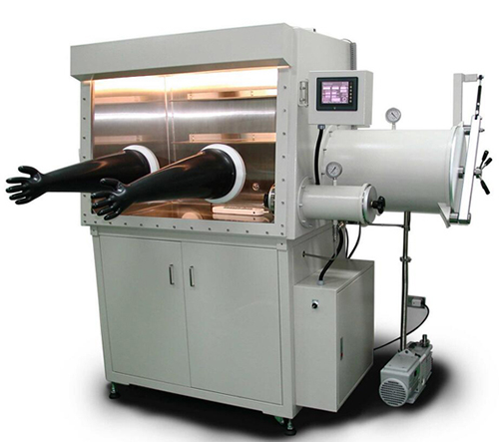
Questions? Suggestions?
Or need a hug from glove box?

