Slide 1
Plasma Cleaning Safety Presentation
Kathleen Maleski
kam645@drexel.edu
August 23, 2018

Slide 2
Why do we care?
Do you need to…
Remove organic impurities and contaminants from a surface?
Enhance the hydrophilicity and/or functionalization of surfaces to achieve a uniform coating?
Clean a rough, porous, or uneven surface?
Treat a surface that is heat- or chemical-sensitive?
Surface treatment that is easy to use and consistent?
Pixabay.com

Slide 3
Why use plasma?
Remove organic impurities and contaminants from a surface?
Plasma can clean organics from a surface without changing bulk properties! In addition, it does not add organic residue, unlike many wet cleaning processes.
Enhance the hydrophilicity and/or functionalization of surfaces to achieve a uniform coating?
Utilizing O₂ plasma, surface activation can take place resulting in hydrophilicity!
Clean a rough, porous, or uneven surface?
There are no surface tension constraints, therefore, it can clean uneven surfaces.
Treat a surface that is heat- or chemical-sensitive?
Plasma occurs at near ambient temperature, minimizing risk of damage to heat-sensitive materials and operates without harsh chemicals.
Surface treatment that is easy to use and consistent?
Plasma is short and efficient, there is no drying step, and is reproducible

Slide 4
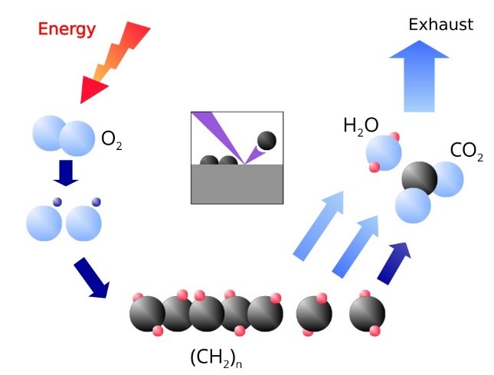
What is Plasma?
Plasma is an ionized gas that consists of ions, electrons, neutral atoms and molecules.
To ignite plasma, electrons are accelerated at low pressures by an radio frequency electric field and acquire energy to ionize the process gas (O₂, N₂, Ar, etc.)
The energy of plasma electrons and ions are strong enough to ionize atoms, break molecules apart to form reactive species, generate excited states, etc., thus breaking down organic contaminants on your surfaces
Altar Technology Group

Slide 5
Types of Plasma
Depending on the process gas and parameters used, plasmas are capable of mechanical work (through ablation or ion bombardment) and chemical work (interaction of radicals)
Plasma can interact with or modify a surface through ablation, activation, deposition, cross linking or grafting
Most common gas sources include Air, O₂, N₂, Ar and H₂
PV-manufacturing.org (Photovoltaic Manufacturing)

Slide 6
Safety Constraints – Electrical
A plasma cleaner is a piece of electrical equipment! Therefore, treat it as such!
RF high voltage exists within the chamber! Never open the chamber when the RF output is ON
The use of metals and organic materials inside the chamber can cause damage and contamination! When using these materials are necessary to your experiment, be sure to consult the superuser, use low RF power and low cleaning time.
Place machine back in idle state once your cleaning has finished.

Slide 7
Safety Constraints - Operational
To ignite plasma, it must be under pressure. Therefore, beware of gas tanks, pressure valves, venting and purging!
If the chamber is filled with high concentration oxygen, a hydrocarbon oil pump cannot be used. We have a oil-free dry pump in the lab for this reason.
No toxic gases are allowed in the input port.
Maximum pressure at the gas inlet port is 15 psi. Recommended gas inlet pressure during operation is 10 psi. Check the gas tanks before use.
The minimum vacuum level for plasma operation is 150 mTorr, however, the vacuum should reach below 50 mTorr.
Mixed process gases can be used (O₂/Ar), consult superuser.
10 psi!

Slide 8
Our Plasma Cleaner
Ar and O₂ – connected
next to TA-MS machine
Lab
notebook
User
manual
User Interface
Plasma
cleaner
Oil-free pump
Recipe
Details
Chamber
Details
Control
Panel

Slide 9
Inlets, On/off
Gas inlet 1 and 2
On/off pump power supply
On/off main power supply

Slide 10
Conclusion
Remember to log your experiment in the lab notebook!!!
NAME | DATE | SURFACE | GAS | RATE | RF POWER | TIME

