Slide 1
Conductivity of MXene film by 4 point probe (Jandel ResTest)
Hao Wang

Slide 2
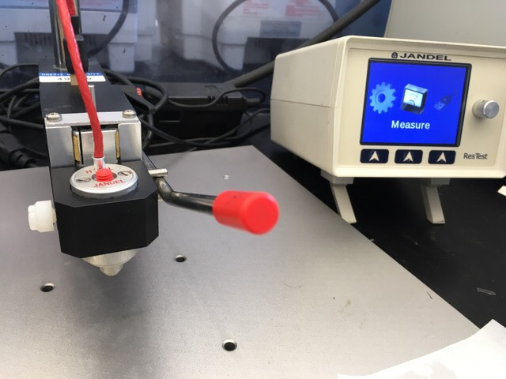
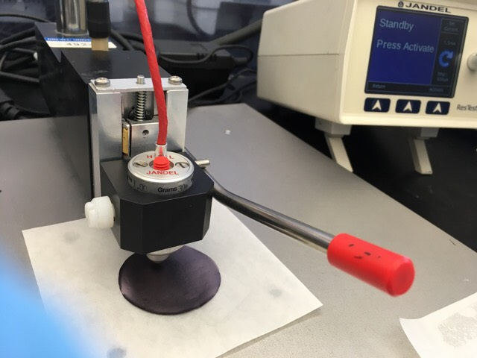
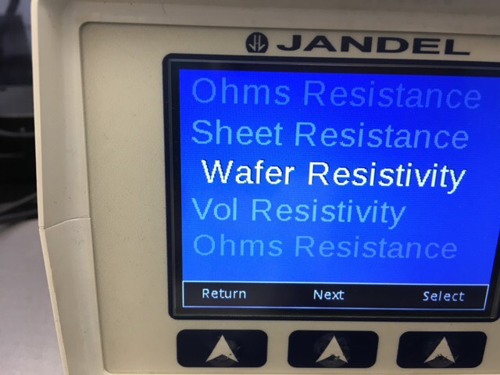
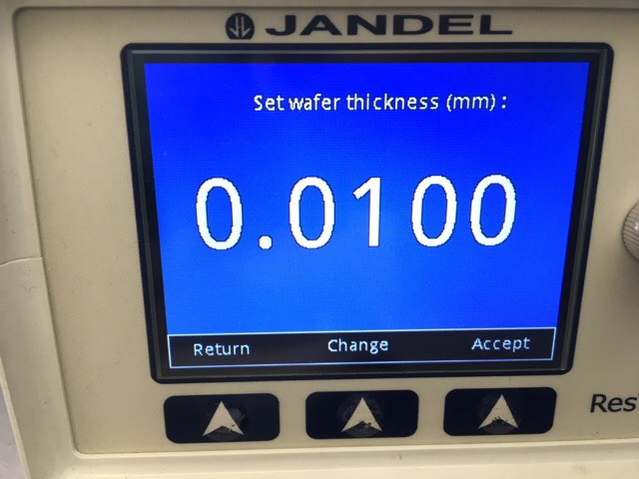
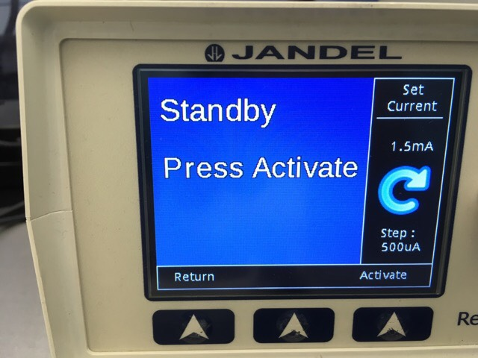
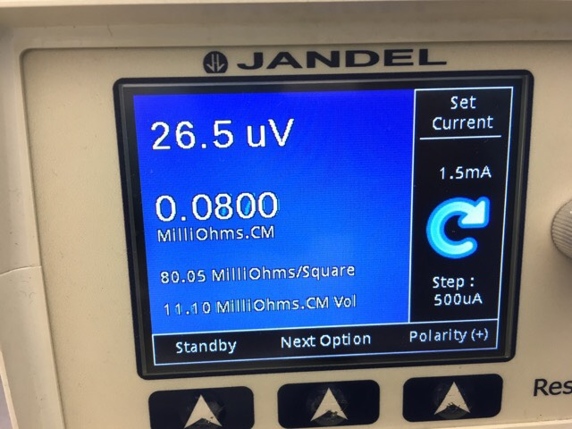
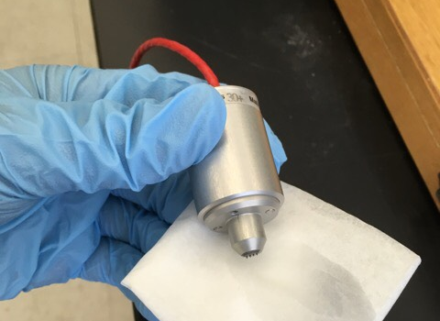
Procedure (Wafer Resistivity)
Set the sample
Caution:
Make sure that turn off current before releasing the probe from the sample
Select ‘Wafer Resistivity’
Enter the sample thickness
Set current
Resistivity is measured
Clean the probe with Ethanol
(Gently)

Slide 3
Link
http://www.jandel.co.uk/downloads/Jandel_four_point_probe_restest.pdf

