Slide 1
Thermogravimetric Analysis (TGA) Safety Concern
6th September 2018
Kanit Hantanasirisakul

Slide 2
TGA-DSC-MS
- Heat the sample
Measure mass
Heat flow
Evolved gas
Charles Potter, TA Instrument

Slide 3
Charles Potter, TA Instrument

Slide 4
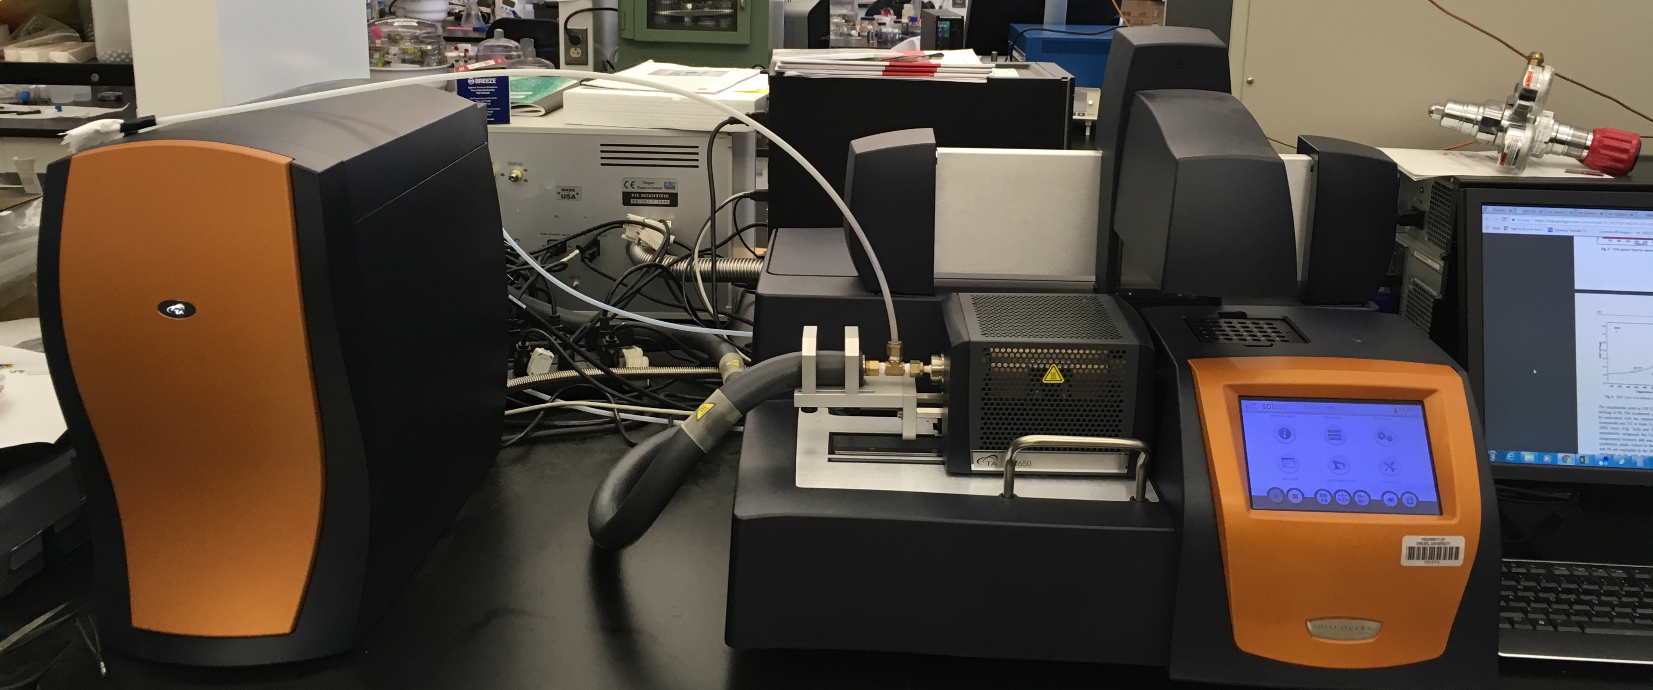
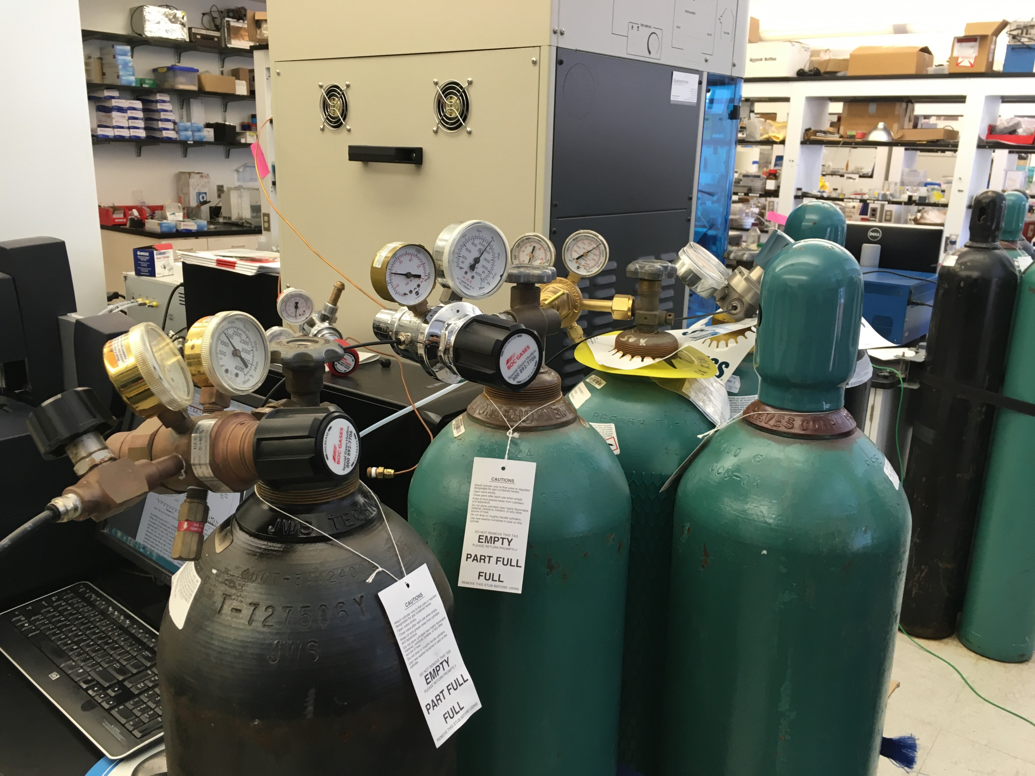
Our setup
Autosampler (moving)
toxic fume
Mass spectrometer
TGA
vacuum (25 Torr)
Gas cylinders
He, N2, air
(refer to gas cylinder safety)
1500 °C

