Slide 1
Vacuum Oven Safety Presentation
Linfan Cui
lc944@drexel.edu
October 22, 2018

Slide 2
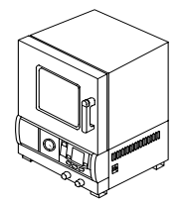
Why use vacuum oven
For a variety of application of heat treatment under vacuum
For drying
For outgassing
For moisture removal.
For annealing
Materials
Thermo-sensitive
Easily oxidized

Slide 3
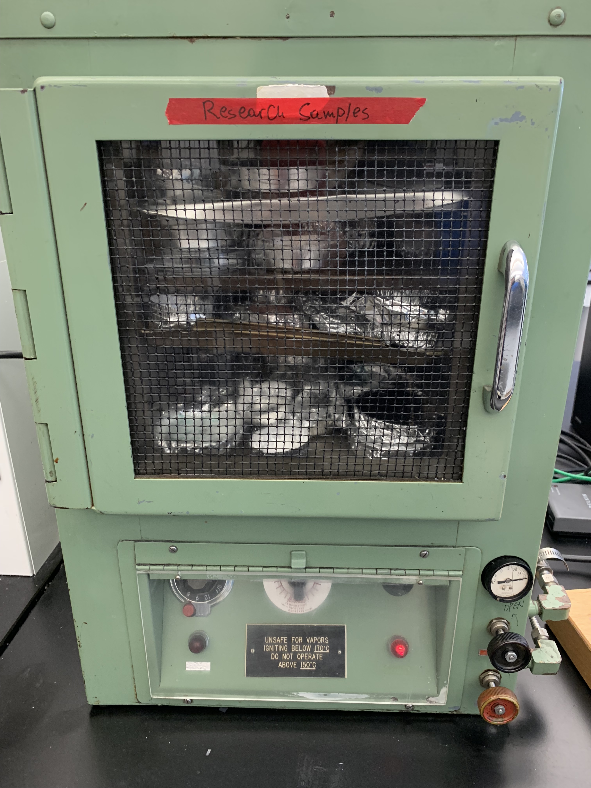
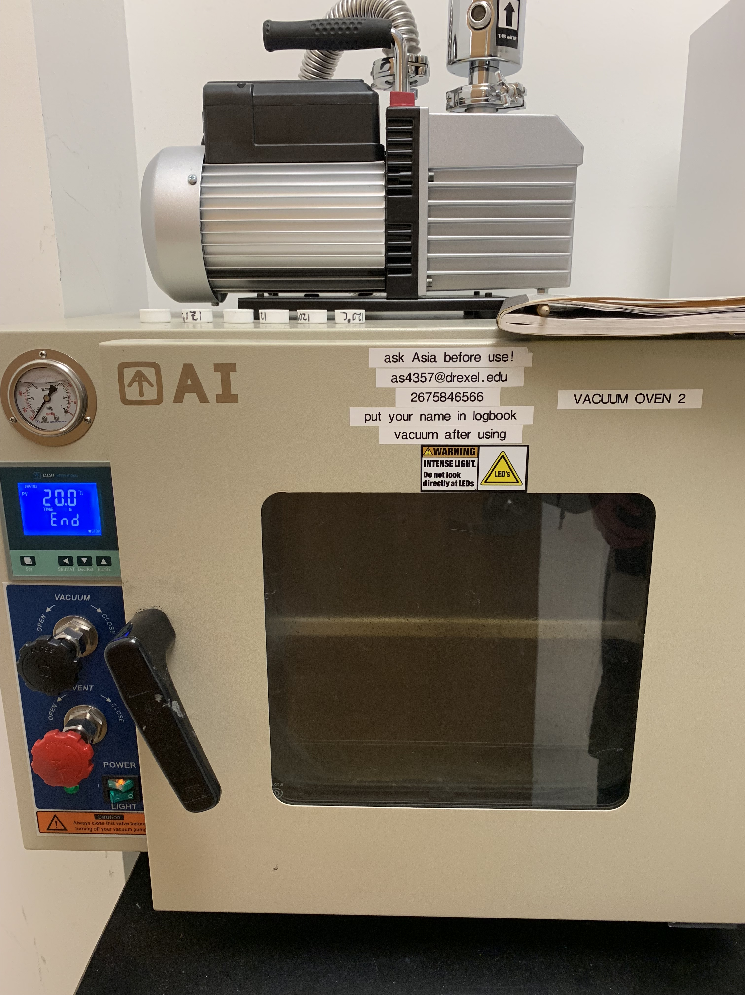
Vacuum ovens in the lab
Control panel
Pump
Vacuum gauge
Vacuum valve
Observation window
Purge valve
Door handle

Slide 4
Operating procedure
Sample loading
Place sample inside of the oven. Make sure that the sample is mostly dry (i.e., there is no visible solvent present). If there are other samples in the oven place your samples away from them to prevent any contamination.
Close the vacuum oven door. Check that the purge valve is closed, if not close it.
Turn the pump on, open the vacuum valve slowly and turn off the pump when reaching vacuum. If the pressure gauge in front of the vacuum oven does not show the pressure going down, hold the vacuum oven door closed.
Sample removing
Close the vacuum valve and slowly open the purge valve
Take out your samples from the vacuum oven.
Pump again to make sure the oven in a vacuum
Notice: if you stop the vacuum pump at an evacuated state, the oil in the pump
may flow backwards inside the oven.

Slide 5
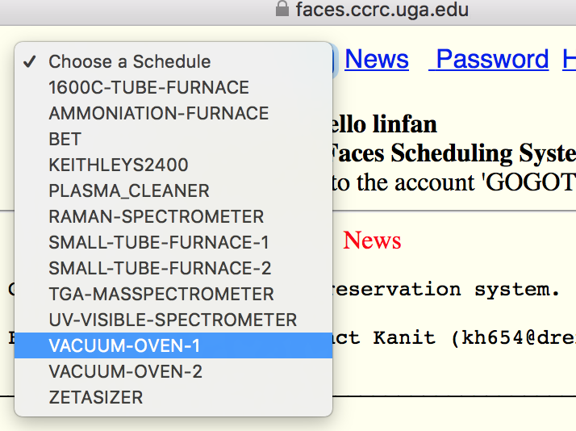
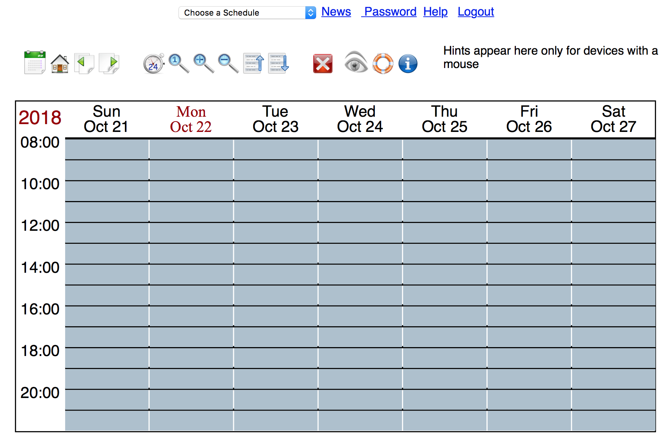
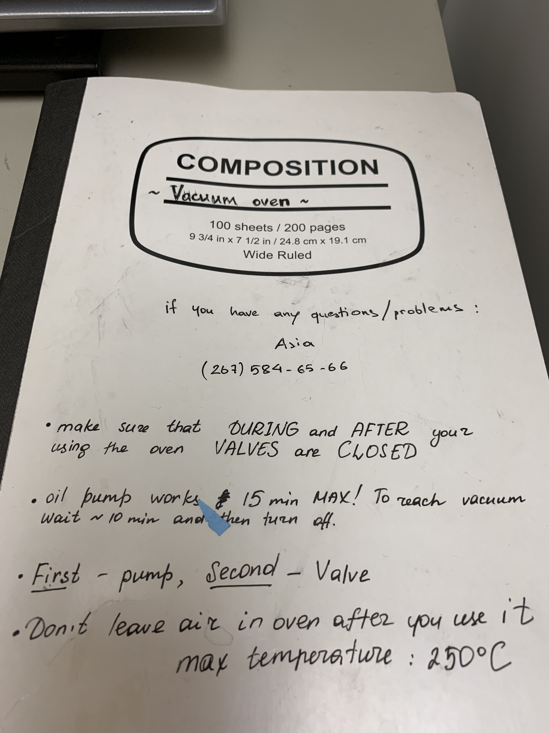
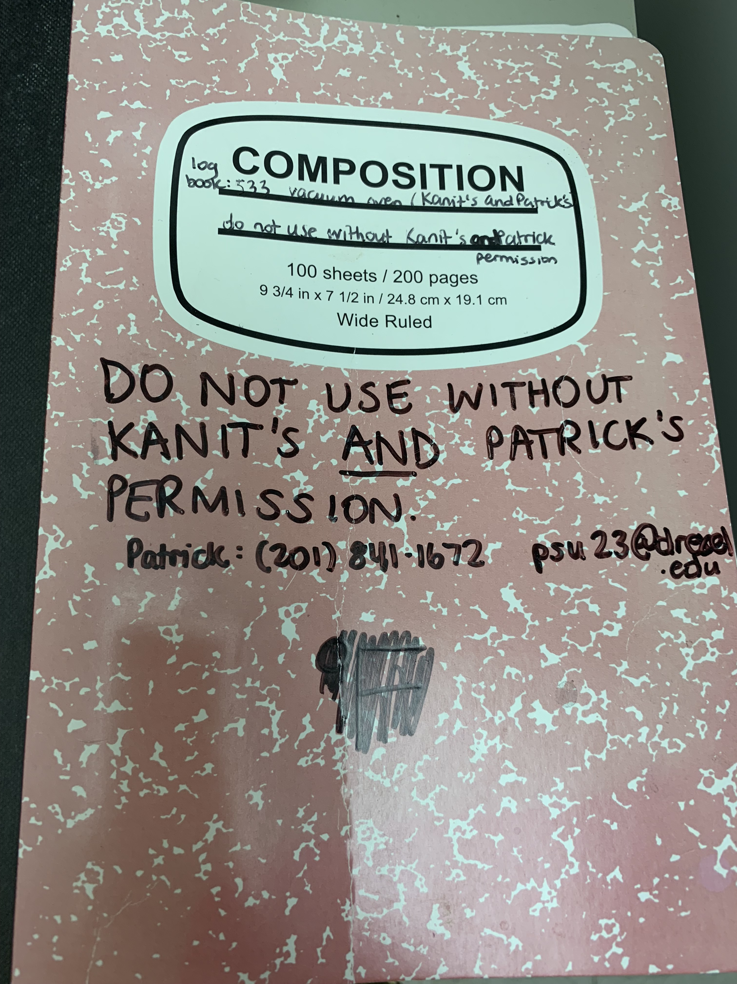
Best practice
Before use
In use
After use
Schedule time on the faces
Familiar with the procedure
Ask super-users
Wear lab coat, goggle and gloves
Follow the procedures
Use the logbook
Clean the oven
Inspect the oven
Make a note in the logbook

Slide 6
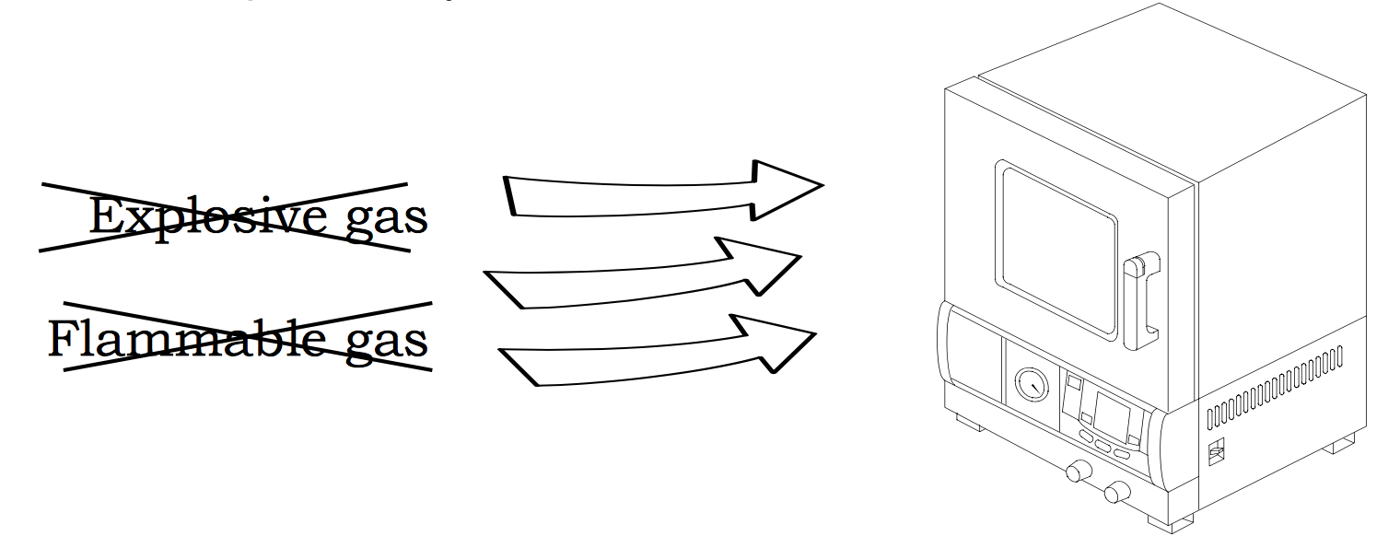
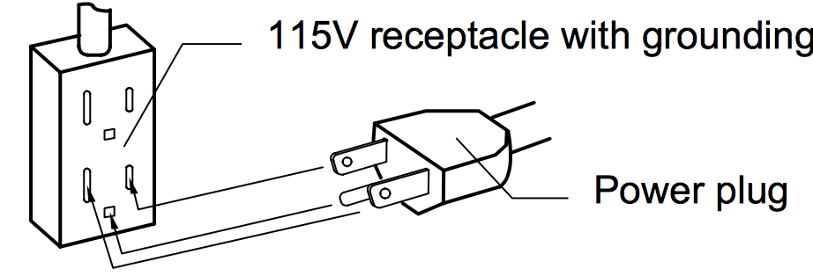
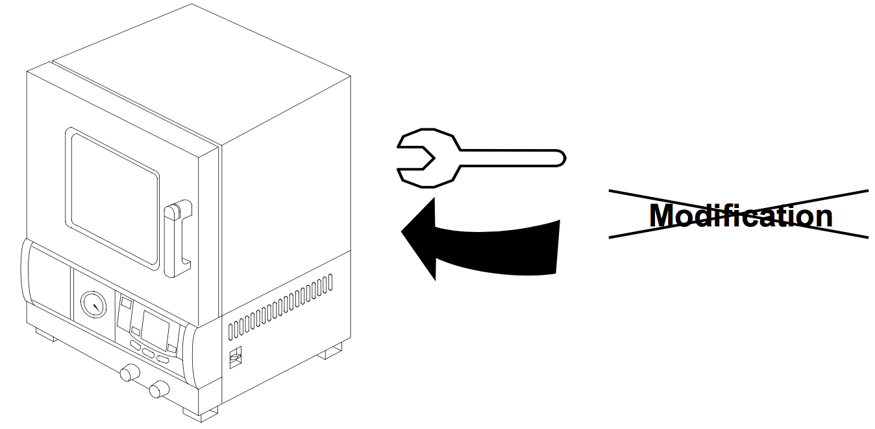
Safety constrains
Do not use the unit in an area where
there is flammable or explosive gas
Always ground the unit
Do not disassemble and modify the oven
Do not touch heat parts

Slide 7
Maintenance
Don’t use corrosive samples
Prevent pump oil flowing back-forward
Don’t use the oil pump too long
Let the oven being a vacuum after using it
Notice the temperature range
Keep the chamber clean
Take care of the oven and your samples

